Slide 1
The Reformation
World History II

Slide 2
Conflicts that challenged the Authority of the Roman Catholic Church
Merchant wealth challenged the Church’s view of usury
German and English nobility disliked the Italian domination of the Church
The Church’s great political power and wealth caused conflict
Church corruption and the sale of indulgences were widespread and caused conflict

Slide 3
Early dissenters
John Wycliffe (1330-1384)
Proposed that all people should be able to read the Bible
Bible should be published in the vernacular
No need for popes, bishops
He was English

Slide 4
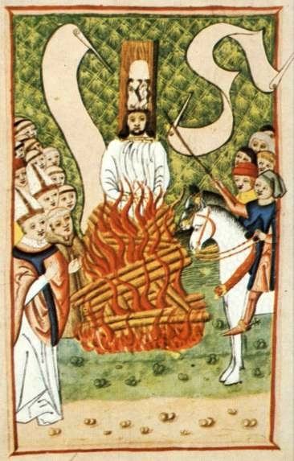
Jan Hus (1369-1415)was not as lucky
Hus said many of the same things as Wycliffe, but added that the church should be nationalized.
He was excommunicated and burned at the stake

Slide 5
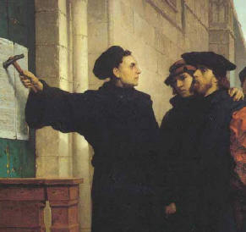
Martin Luther
Said that salvation was gained by faith alone
The Bible is the ultimate religious authority (not the doctrines and practices of the Church)
All people are equal before God
The Bible does not allow for the sale of Indulgences
All of this was included in his document,
The 95 Theses

Slide 6
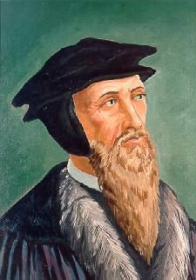
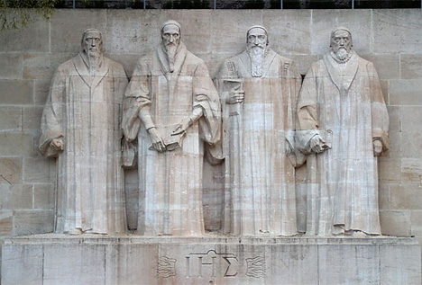
John Calvin
Believed that God has determined who will be saved and who will be condemned through Predestination
Faith is revealed by living a righteous life
Hard work, well done, is pleasing to God (work ethic)
Expanded the Protestant Movement

Slide 7
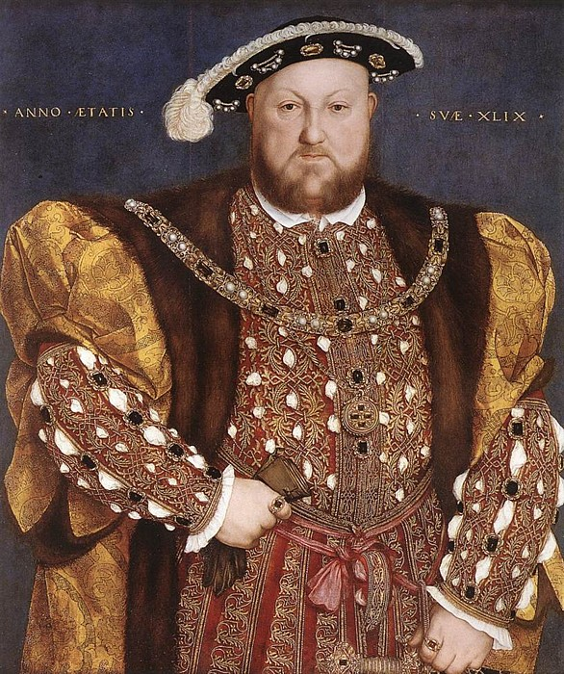
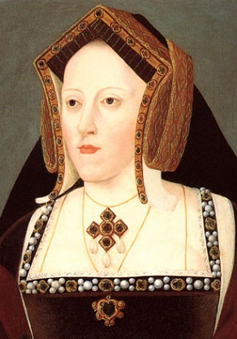
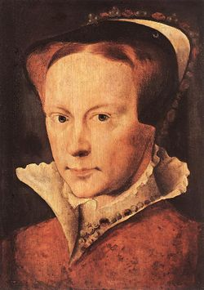
Reformation in England
King Henry VIII was married to Catherine of Aragon but their only child was a girl named Mary

Slide 8
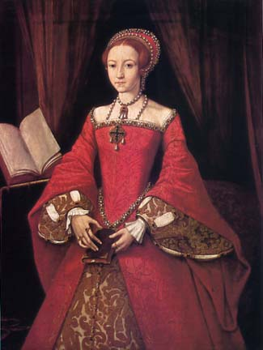
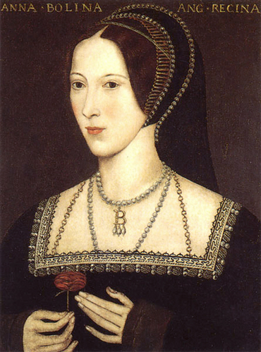
Henry wanted to divorce Catherine to marry Anne Boleyn, whom he hoped would give him a son…
The Pope refused Henry’s request so the King then decided to dismiss the authority of the Roman Catholic Church and proclaimed himself Head of the Church in England (the Anglican Church)
Henry went on to marry Anne, only to father another girl, Elizabeth

Slide 9
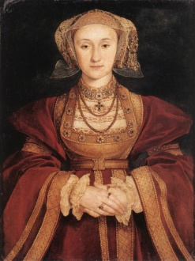
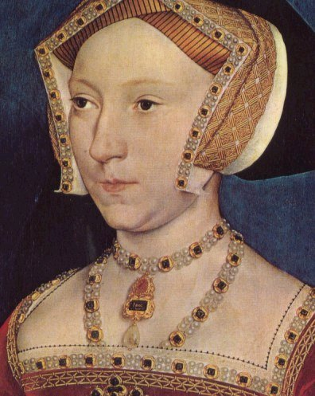
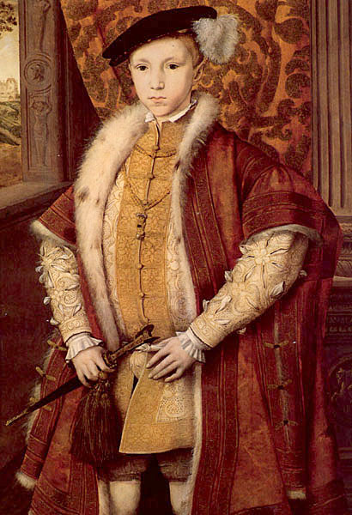
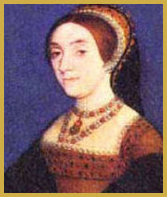
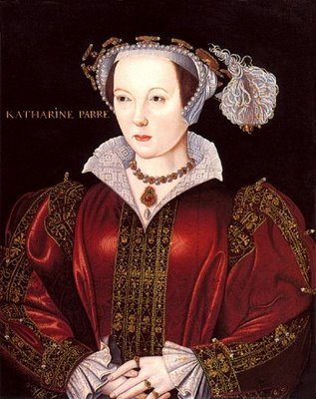
Henry VIII finally has a son, Edward, with his third wife, Jane Seymour, who dies shortly afterward
Henry marries three more times, but never has any other children.
Henry VIII lasting impact:
Broke with Roman Catholic Church
Created a new English (Anglican) church with himself as the head
Took away lands and wealth of the Catholic Church in England

Slide 10
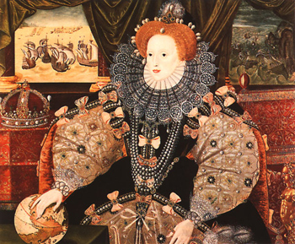
Queen Elizabeth I
Head of Anglican Church
Tolerance for dissidents
Expansion and colonialism
Victory over Spanish Armada
in 1588
– signals England’s rise to
be a great sea going power

Slide 11
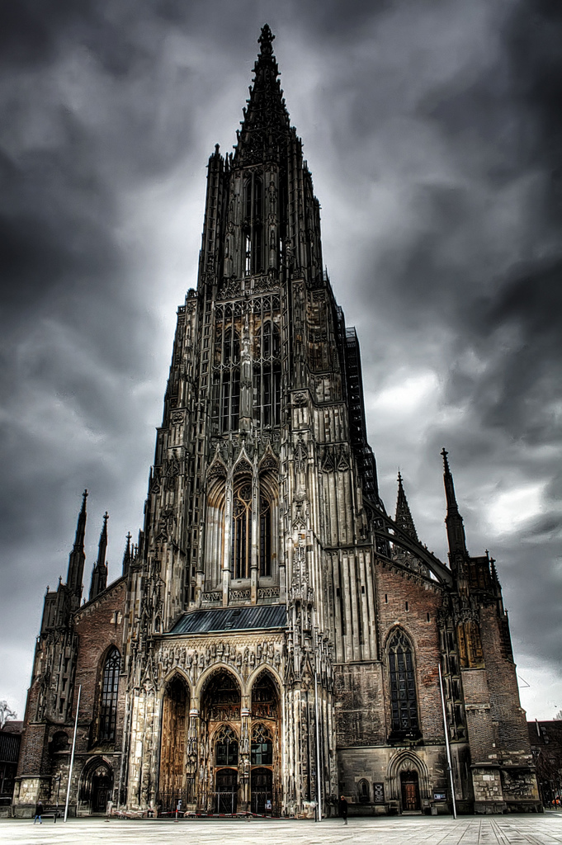
Impact of Reformation in Germany
Princes in Northern Germany converted to Protestantism, ending the authority of the Pope in their states.
The Hapsburg family and the authority of the Holy Roman Empire continued to support the RCC.
Conflict between Protestants and Catholics resulted in devastating wars: Hapsburg-Valois Wars 1521-1555 and the Thirty Years’ War 1618-1648.

Slide 12
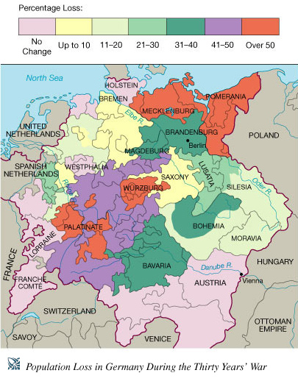
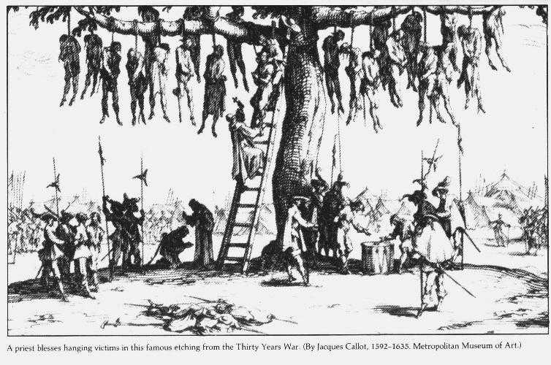

Slide 13
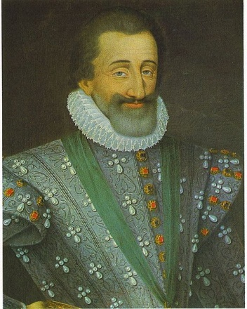
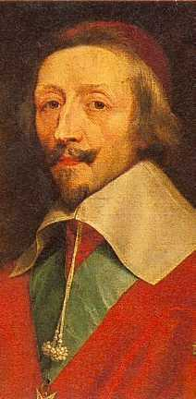
Impact of Reformation in France
Catholic monarch, Henry IV, granted Protestant Huguenots freedom of worship by the Edict of Nantes
Cardinal Richelieu changes the focus of
the Thirty Years’ War from a religious to a political conflict by siding with the Protestants against the Catholics

Slide 14
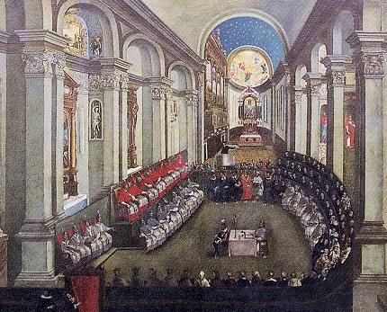
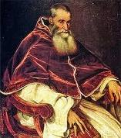
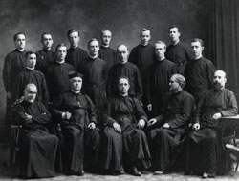
Catholic Reformation (The RCC Strikes Back)
The Council of Trent reaffirmed most Church doctrine and practices.
The Society of Jesus (Jesuit order) was founded to spread Catholic doctrine around the world.
Pope Paul III

Slide 15
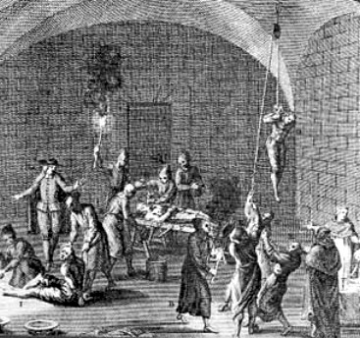
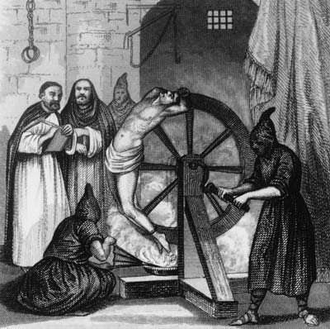
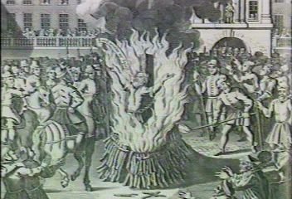
The Inquisition was used to reinforce Catholic doctrine.

Slide 16
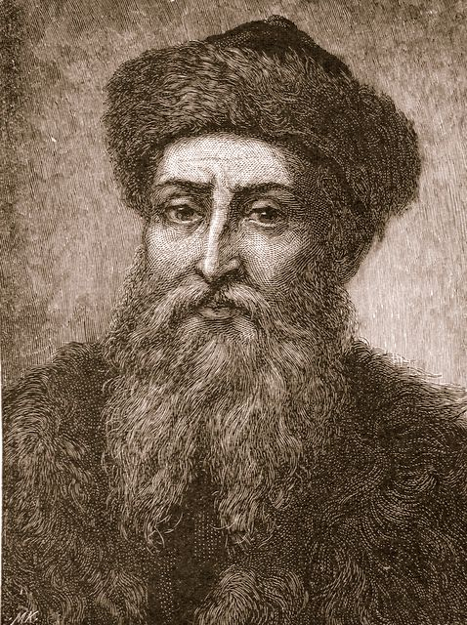
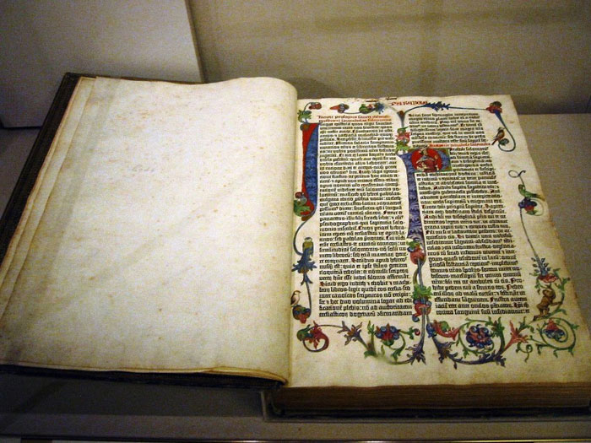
Role of the Printing Press
Growth of literacy was stimulated by the Gutenberg printing press.
The Bible was printed in English, French, and German
These factors had an important impact on spreading the ideas of the Reformation and the Renaissance
Secularism
Individualism
Humanism

Slide 17
The Big Idea
What were some of the changing cultural values, traditions, and philosophies during the Reformation?
Growth of secularism
Growth of individualism
Eventual growth of religious tolerance

