Slide 1
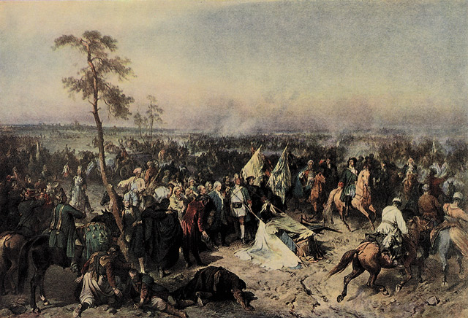
The Great Northern War
Dylan Levins
Angela Guy
B1

Slide 2
What Was it?
It was a conflict in which a coalition led by the Tsardom of Russia, which successfully contested the supremacy of the Swedish Empire in Northern central Europe to Eastern Europe.

Slide 3
How it Started
When the alliance of Denmark of Norway, Saxony, Poland-Lithuania and Russia Started a war on the Swedish, by attacking Swedish Holstein-Gottorp, Swedish Livonia, and Swedish Ingria.

Slide 4
The Initial Leaders of the Anti-Swedish Alliance
Peter I the Great of Russia
Frederick IV of Denmark–Norway
August II the Strong of Saxe-Poland-Lithuania

Slide 5
Peter I The Great
Became Tsar (c-zar) in 1682 after the death of his older half brother Feodor
He did not become the real ruler until about 1689
He decided to start reforming the country, changing the Russian tsardom into a modern empire depending on trade and a real strong professional army and navy
He expanded the size of Russia a lot during his time

Slide 6
Frederik IV
Focused on changing his state to an absolute monarchy, in a way similar to Charles XI.
He didn’t reach his main goal which was to gain back the former eastern Danish provinces lost to Sweden
He did put an end to the Swedish threat south of Denmark.
Ended Sweden's exemption from the Sound Dues which were transit taxes or tariffs on cargo moved between the North Sea and the Baltic Sea.

Slide 7
August II The Strong
Known as the elector of Saxony and another cousin of Charles XII
He gained the Polish crown after the death of Jan Sobieski in 1696
His intentions to transform the Polish–Lithuanian Commonwealth into an absolute monarchy were not recognized
He had a meeting with Peter the Great in Prawa in September 1698. There they made the plans to attack Sweden
The meeting became legendary for its greedy ambitions

Slide 8
Troops
In 1700 Charles XII had a army of 77,000. In 1707 this number grew to at about 120,000 even with the casualties of battles.
Russia was able to move a larger army but could not put all of them into battle at the same time. The Russian mobilization system was not effective and the growing nation needed to be defended in many places. A grand mobilization covering Russia's large territories would have been unreal.
Denmark contributed 20,000 men in their invasion of Holstein-Gottorp and more on other sides.
Poland and Saxony together could move about 100,000 people.

Slide 9
Treaties
Treaty of Altranstädt- Augustus had to end his claims to the Polish throne and his partnership with Russia.
Treaties of Stockholm 1719- Swedish-Hanoveranian and Swedish-Prussian
Treaty of Frederiksborg 1720- The Dano-Swedish
Treaty of Nystad 1721- The Russo-Swedish

Slide 10
Resourses
Wikipedia.org
http://depts.washington.edu/baltic/papers/greatnorthernwar.htm

Slide 11
Questions
When did Peter the Great become the founder of Saint Petersburg?
Before St. Petersburg was a beautiful European city what was it?
How many serfs (slaves) died creating St. Petersburg?
What happened to the size of Russia during Peter the Greats rule?
In the early 1700’s what happened to Charles XII’s army?
How did the Great Northern War start?
How old was Peter the Great when he took Throne?
Out of the 14 children Peter had with his two wives how many made it to adult hood?
What did Frederik IV start to make Sweden pay in order to move cargo which they never had to pay before?
What was the meeting between August II The Strong and Peter the Great know for when they talked about attacking Sweden?

Slide 12
Answers
May 27, 1703
A marshy swamp
Estimated 25,000 to 100,000 people
It grew a lot
It almost doubled in size
When Norway, Poland, and Russia agreed to attack Sweden
Ten-Years-Old
Three
The Sound Dues which were transit taxes or tariffs on cargo moved between the North Sea and the Baltic Sea
It’s Greedy Ambitions

