Slide 1
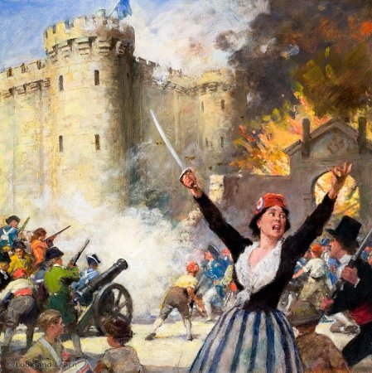
Bastil----------------------------------------------------------------------------------------------------------------------------------------------------------------------------------------------------------------------------------------------------------------------------------------------------------------------------------------------------------------------------------------------------- + Storming The Bastille Storming of the Bastille
By: Khari Lomax

Slide 2
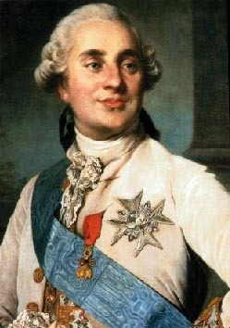
Bastille was a prison in Paris , France. It was a symbol of the King's absolute and arbitrary power

Slide 3
A Group of craftsmen & salesmen decided to fight back . They stole about 28,000 rifles

Slide 4
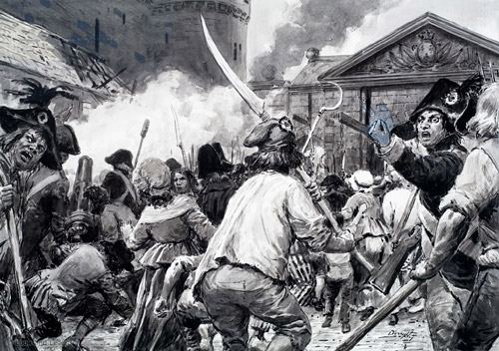
On the morning of July 14 , 1789 they decided to attack the Bastille.

Slide 5
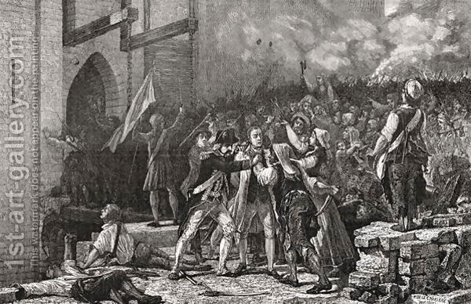
At the time of the storming, the Bastille was only guarded by a few soldiers.

Slide 6
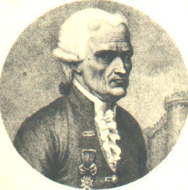
The crowd wasn’t big enough to impress the guards. The Marquis de Launay, feared anger among the revolutionaries, accepted to meet their representatives inside the prison.

Slide 7
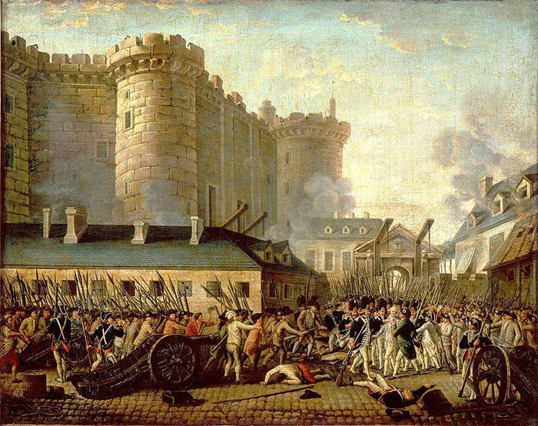
But the negotiations ended when a group of revolutionaries entered the Bastille. The guards were ordered to fire, killing hundreds of people.

Slide 8
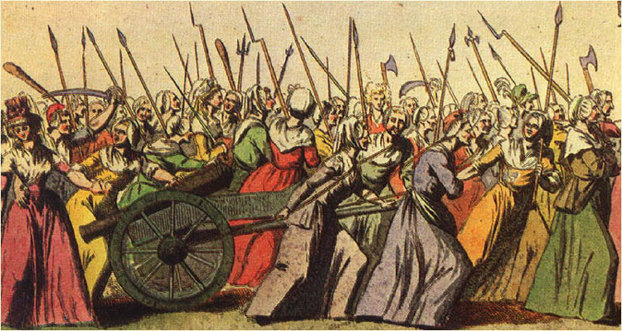
At 4 pm , Marquis De Launay surrendered to the people & finally let them in the prison.

Slide 9
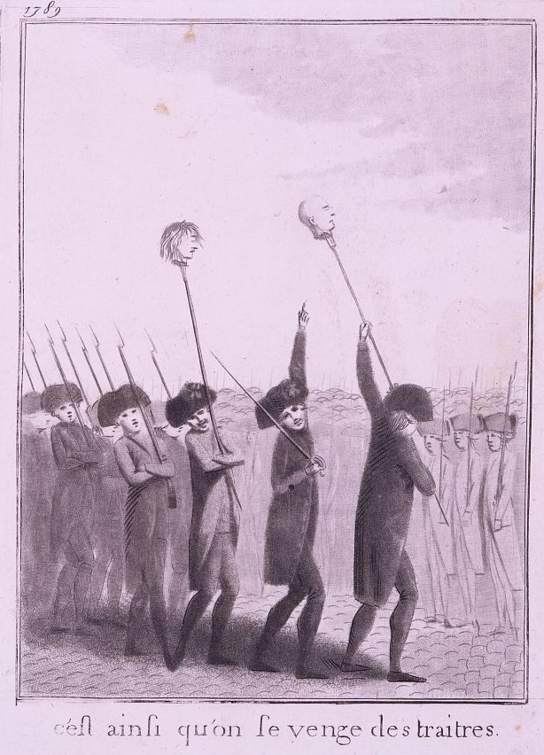
The guards were violently killed & Marquis de Launay was beheaded, with his head put on a stake & carried all over the city as a sign of victory.

Slide 10
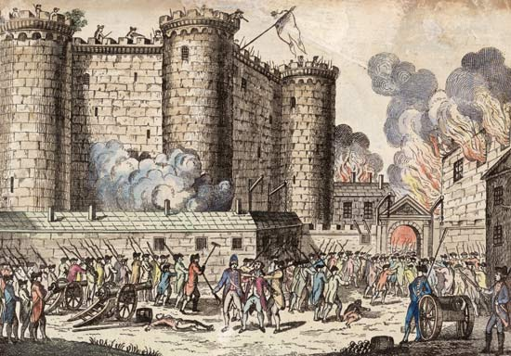
There weren't many prisoners in the Bastille at the time of the storming; only 7 people were freed. That very night, 800 men began to destroy the Bastille.

