Slide 1
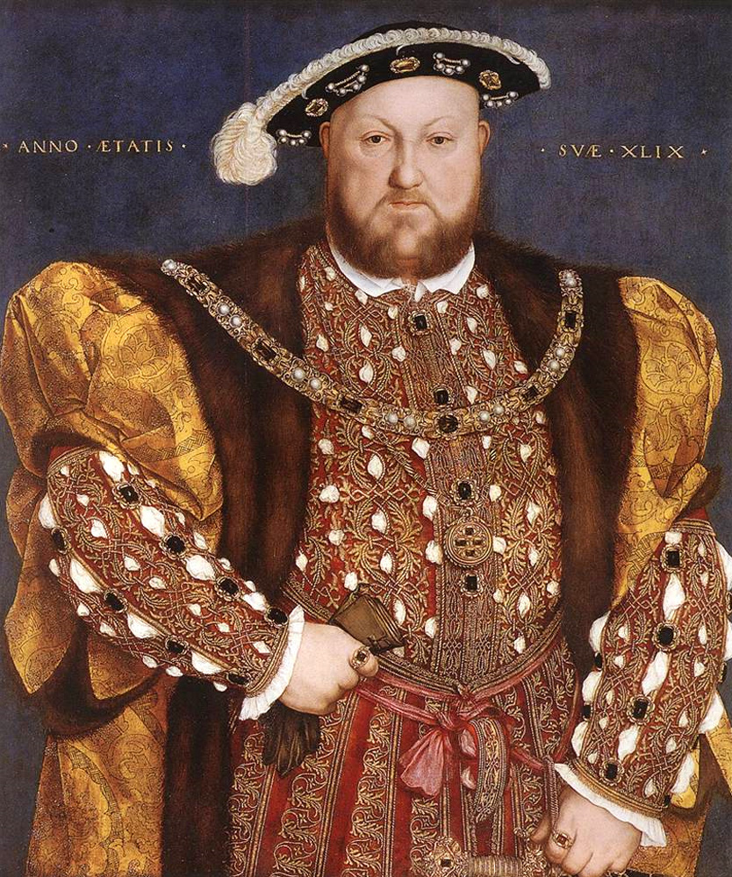
Renaissance Royalty
Zach Kreib

Slide 2
King Henry VIII
Ruled 1509-1547
Son of King Henry VII
6 wives (divorced, beheaded, died, divorced, beheaded, survived)
3 children- Mary, Elizabeth, Edward
Renaissance man (poet, hunter, athlete, musician, supported humanistic learning)

Slide 3
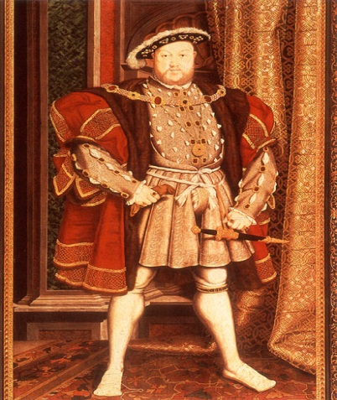
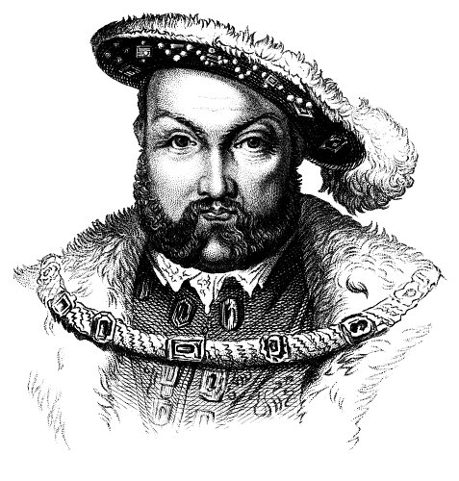
Henry VIII Cont.
Protestant Reformation
Henry wanted divorce from 1st wife, but Pope wouldn’t grant it
Henry denied the Pope any power and declared himself head of the English Church
Beheaded Sir Thomas More because he remained loyal to the Pope

Slide 4
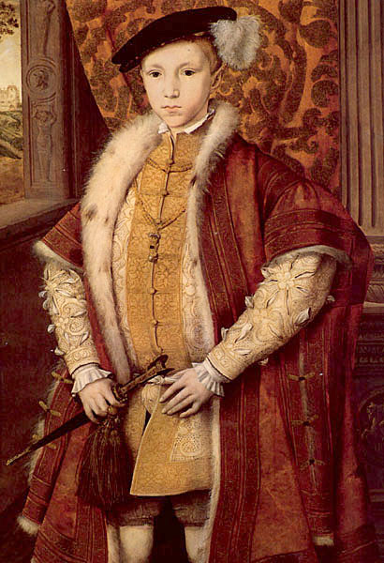
King Edward VI
Son of Henry VIII
Reigned 1547-1533, started at age 9
Only ruled in name, relatives had real power
Died of tuberculosis

Slide 5
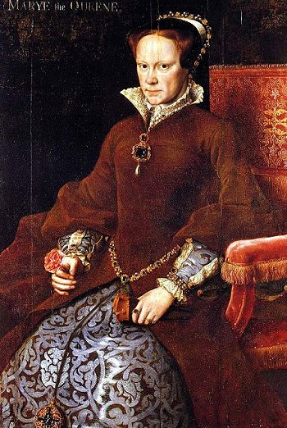
Queen Mary
Reigned 1553-1558
Devout Catholic, executed many Protestants and gained name “Bloody Mary”
Restored Pope’s power in England
Married King Philip II of Spain

Slide 6
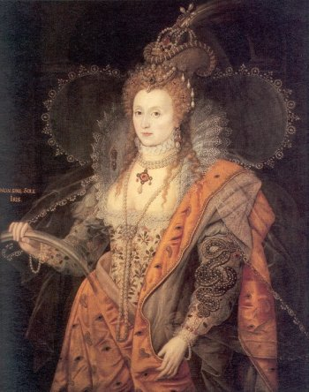
Queen Elizabeth I
Reigned 1558-1603
“Virgin Queen” because never married
Reestablished the Church of England and rejected the Pope’s authority
Had Mary Stuart, Queen of Scotts, beheaded
Ruled when England’s Royal Navy defeated King Philip and Spanish Armada

Slide 7
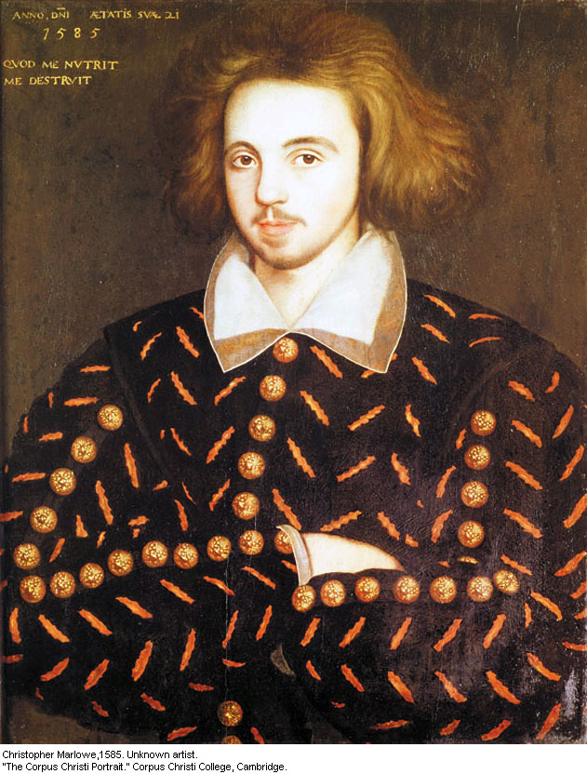
Christopher Marlowe
Born in Canterbury, England
Baptized 2/26/1564
Died 5/30/1593 (stabbed to death)
Attended The King’s School and Corpus Christi College, Cambridge for Drama
Alleged secret agent for Sir Francis Walsingham

Slide 8
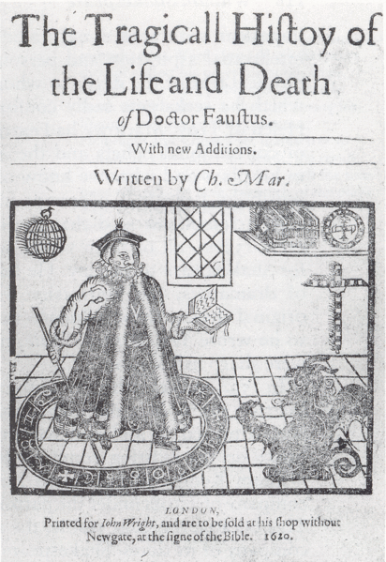
Dramas
Dido, Queen of Carthage (believed to be his 1st)
Tamburlaine the Great
The Massacre at Paris
The Tragicall History of the Life and Death of Doctor Faustus

Slide 9
The Tragicall History of the Life and Death of Doctor Faustus
Based on the German Faustbach
First dramatized version of the Faust legend
A man sells his soul to the devil for power and knowledge
Themes- sin, greed, death, obligation (choice), good vs. evil (recognize difference but chooses evil)
Motifs- magic

Slide 10
Doctor Faustus Cont.
"Why this is hell, nor am I out of it. Think'st thou that I, who saw the face of God, And tasted the eternal joys of heaven, Am not tormented with ten thousand hells In being deprived of everlasting bliss?“ - Mephistophilis
Faustus asks Mephistophilis how he is out of Hell
Answer implies that Mephistophilis has a deep knowledge of God and wants to return to Heaven

Slide 11
Legend
Alleged government spy
Death- stabbed above the right eye during an argument for unknown reasons
Supposed atheist
Admired and influential artist (Shakespeare’s tribute As You Like It)

