Slide 1
The Bread March
By: Marianna Hill
Group B1

Slide 2
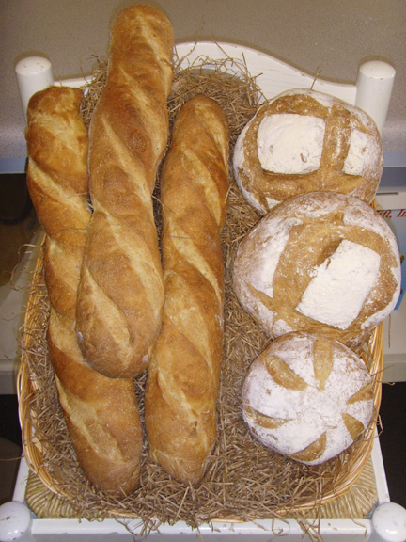
Before the March
Bread was the main food of consumption for the French
The French spent about half their money on bread

Slide 3
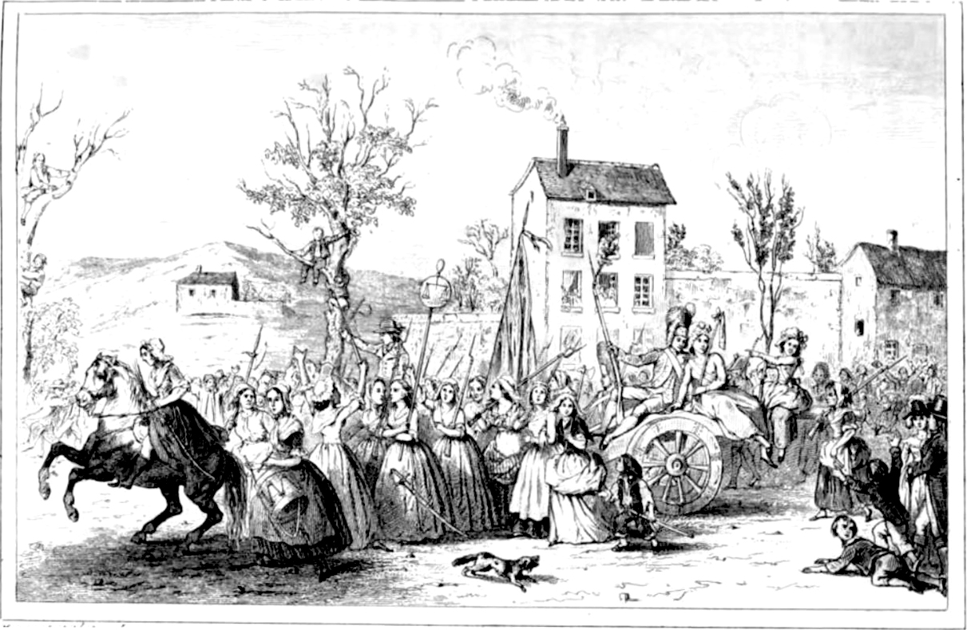
The Bread March is also called the March of Versailles

Slide 4
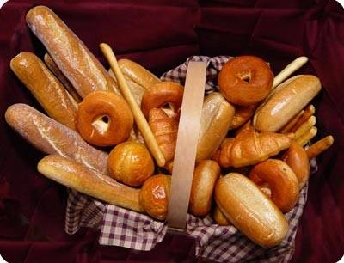
The cost of bread rose about 90% in 1 year, between 1788 and 1789

Slide 5
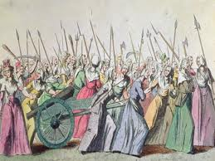
When the cost of bread rose, the people of France were angry

Slide 6
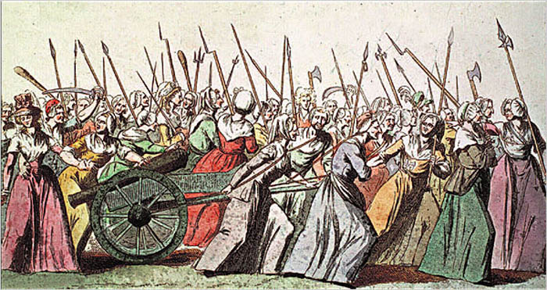
The angered women formed a mob and marched to show their discontent about the bread`s cost!

Slide 7
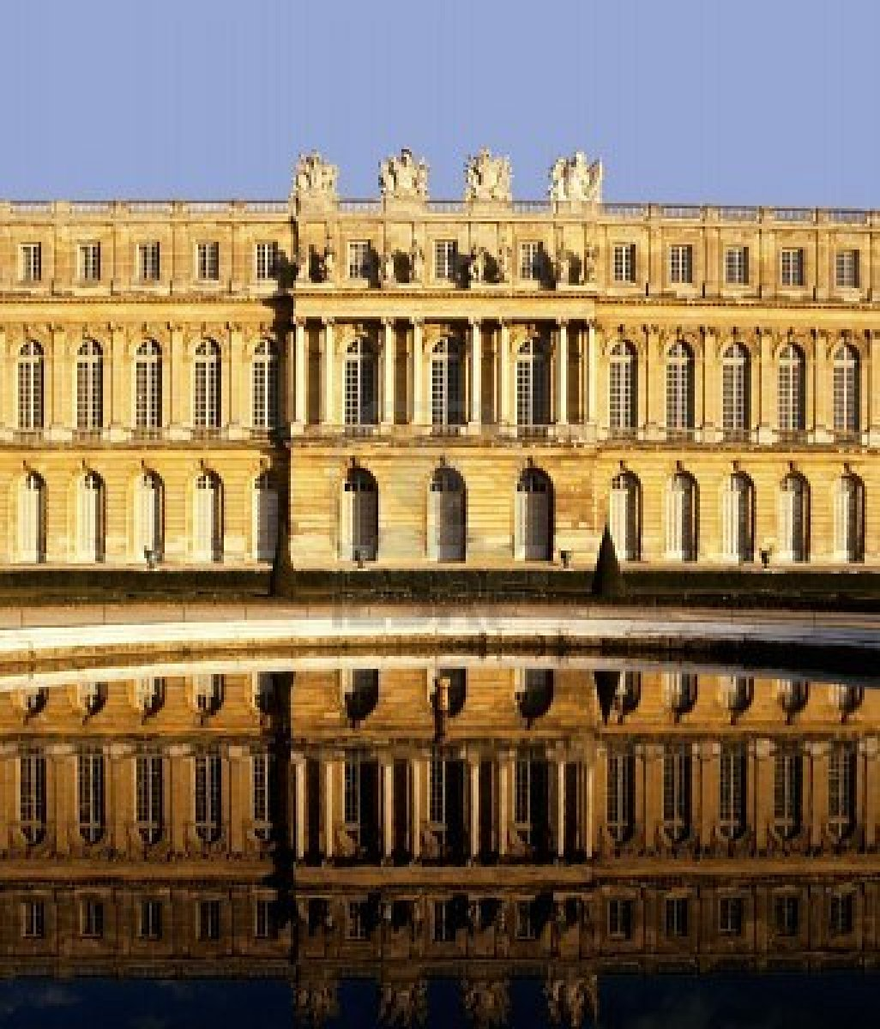
*The women marched through the streets of France, eventually ending up at the Palace of Versailles

Slide 8
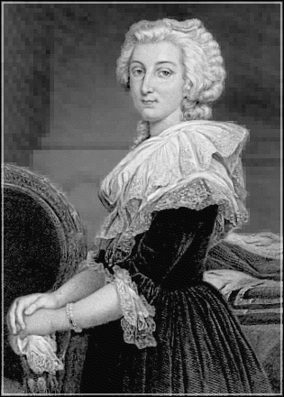
*They stormed through the castle, and destroyed Marie Antoinette`s chambers

Slide 9
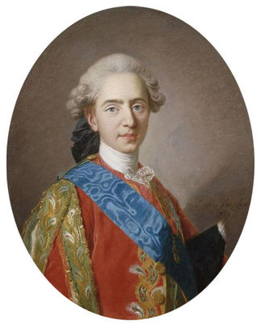
Due to the threat on Marie Antoinette, King Louis XVI decided to move his family and the French Court to Paris

Slide 10
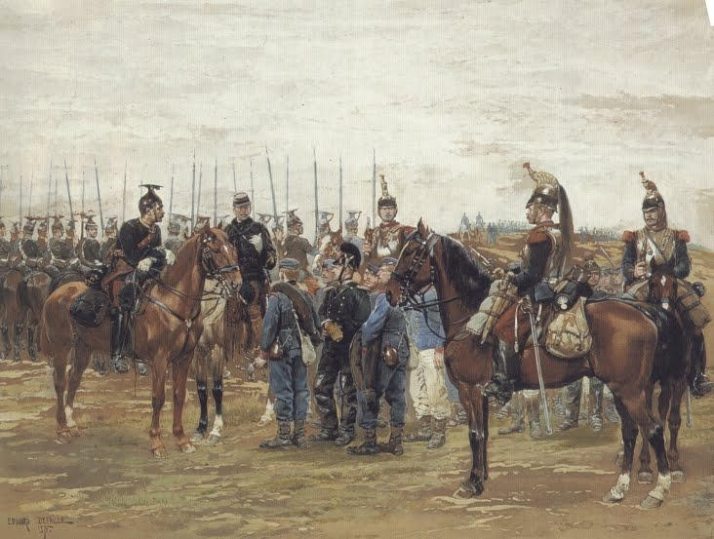
The issues with the Bread March included the country starting its revolution, the king eventually being killed, and France going into war with other countries

Slide 11
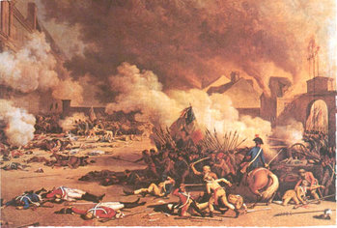
The Bread March left many injured and killed many guards guarding the Palace of Versailles

Slide 12
Sources
http://jspivey.wikispaces.com/file/view/FrenchPeasantBread.jpg/99149733/FrenchPeasantBread.jpg
http://www.openzine.com/images/IssueImages/IloadImage/434855913045GOA_Medium.bmp
http://www.ehow.com/about_4572244_food-shortages-french-revolution.html
http://www.historywiz.org/womensmarch.htm
http://us.123rf.com/400wm/400/400/davidmartyn/davidmartyn0612/davidmartyn061200027/646998-palais-palace-of-versailles-paris-france-europe.jpg
http://www.wpclipart.com/famous/Marie_Antoinette_BW.png
http://www.screentrek.com/images/king-louis-xvi.jpg
http://upload.wikimedia.org/wikipedia/commons/6/6f/MarchWomenVersailles5-6october1789.jpg
http://jspivey.wikispaces.com/file/view/350px-French_Revolution-1792-8-10.jpg/31595635/350px-French_Revolution-1792-8-10.jpg

