Slide 1
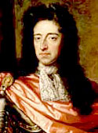
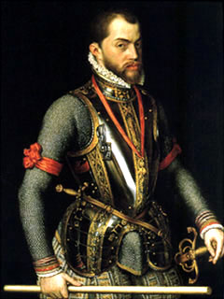
Gabrielle Brannon & Raquel Mangrum !
Phillip II of Spain & William III of Orange .
November 29, 2011
1B

Slide 2
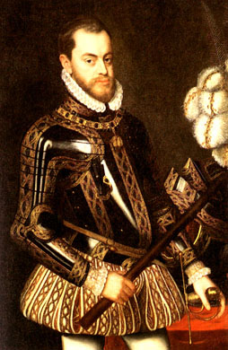
Phillip II of Spain
Gabrielle Brannon
H1

Slide 3
Basic information
He was born May 21, 1527
Born in Valladolid, Spain
He died September 13, 1598
He died in El Escorial, Spain
He died because of a unspecified cancer
His religion was Roman Catholic
His occupation was Royalty
He was King of Spain from 1556-1598

Slide 4
Family
Father: Charles V (Holy Roman Emperor) Mother: Isabella of Portugal
Wife(s):Princess Maria Manuela of Portugal, Mary Tudor and Elisabeth of Valois Anna of Austria
Sons: Don Carlos of Spain and Phillip III
Daughters: Isabella Clara Eugenia and Catherine Micaela

Slide 5
Early age
He received education in Spain by his tutor Dr. Juan Martinez Pedernales.
As he got older he started being more interested in books and studies then army and swords.
Philip grew up brave, self-possessed and distrustful. He was beloved by his Spanish subjects, but utterly without the power of attracting men of other races.
His power of work was unbounded, and he had an absolute love of reading.

Slide 6
While Phillip II took the throne
Europe was experiencing religious wars caused by the Reformation.
Phillip responded like a true crusader when the pope called on all Catholic princes to take up arms against mounting power over the Ottoman empire.
More than 200 Spanish and Venitan defeated a large Ottoman fleet in a fierce battle near Lepanto.

Slide 7
Accomplishments
Because Phillip II was the king’s nephew he seized the Portuguese kingdom. Portuguese strongholds in Africa, India, and the East Indies, he then had an empire that circled the globe.
By 1600, American mines had supplied Spain with an estimate of 339,000 pounds of gold. Between 1550 and 1650, about 16,000 tons of silver was unloaded from Spanish galleons or ships.
He claimed about a fourth or a fifth of every shipload of treasure as his royal share.
With his wealth Spain was able to support a large standing army with about 50,000 soldiers.

Slide 8
Accomplishments cont.
He believed it was his duty to defend Catholicism against the Muslim of the Ottoman Empire and the Protestants of Europe.
In 1588 he launched the Spanish Armada in an attempt to punish Protestants England, and it’s queen, Elizabeth I.
Although his setback seriously weakened Spain, his wealth gave it the appearance of strength for a while longer.

Slide 9
Decline
Severe inflation.
Population growing, and people demanding for food and goods.
Silver bullion flooded the market, it’s value dropped.
People needed more and more silver the buy things.

Slide 10
Decline cont.
Spain expelled the Jews and Moors, which made them lose valuable artisans and business people.
Spain's noble's did not have to pay taxes.
The tax burden fell on the lower class which prevented them to start their own business.
Never had a middle class.

Slide 11
Death
Philip II died in El Escorial, near Madrid, in September 1598. His death, which was very painful, involved a severe attack of gout, fever and dropsy.
For 52 horrific days the King deteriorated. He could no longer be moved to be washed due to pain
They cut a hole in his mattress for the release of bodily fluids.
He was succeeded by his son Philip III.

Slide 12
Questions
How was Phillip II personality ?
What happened after the king of Portugal died and what did Phillip seize?
How did Spain weaken?
What happened after Phillip raised taxes in Netherland?
What happened after Spain expelled the Jews and Moors?

Slide 13
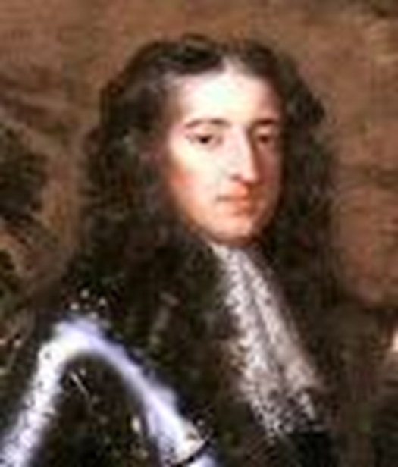
William III (of Orange) 1650-1702
Raquel Mangrum

Slide 14
His birth & history
William was born on 4 November 1650 in The Hague, Netherlands.
William II of Orange, died just before his birth.
His mother Mary was English, the daughter of Charles I.

Slide 15
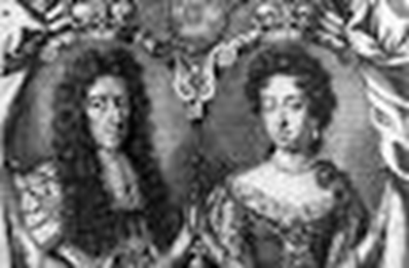
The Beginning
For the first two decades of Williams life the Orange family was out of office.
In 1672 Louis XIV of France invaded the country.
In 1677, William married his cousin Mary

Slide 16
The beginning cont.
William was invited to be 'Stadtholder‘(the chief magistrate of the United Provinces of Holland also, the governor or lieutenant governor of a province) of the Netherlands and its military commander
He succeeded in driving the French out of the Netherlands and became a champion of Protestantism in Europe.

Slide 17
The decline
Next 8 years he was often away fighting, first in Ireland and then on the Continent, leaving his wife to rule in his absence.

Slide 18
The decline cont.
1697, under the terms of the Treaty of Ryswick, Louis XIV surrendered much of the territory
He had won by conquest and recognized William as England's king.

Slide 19
The end
Mary died of smallpox in 1694, leaving William to rule alone
William died on 19 March 1702, after falling from his horse at Hampton Court.

Slide 20
Questions

