Slide 1
Paradox of Independence
Historical Foundations for Modern Latin America: A Brief Introduction to 19th-Century Latin America

Slide 2
Lecture Outline
Chronology
1806-1825 Wars for Independence
1825-1870 The Middle Period
1870-1914
Neocolonial Era
Questions to consider
Collective Exercise: Independence V Revolution
Middle Period: Age of Chaos & Anarchy
Major Trends: Neocolonialism, Positivism & the Modernistas

Slide 3
Questions to consider…
Does historical paradox hinder “modernization” in Latin America?
What constitutes modernization?
Can democracy work in Latin America?
Will democracy or capitalism promote peace and development in the region?

Slide 4
Independence & Disunity
Revolts, Revolution & Independence
Haiti, Mexico & New Granada
Geographic Disunity

Slide 5
Toussaint L’Ouverture Jean-Jacques Dessalines
On Toussaint’s execution…
“What could the death of one wretched Negro mean to me?”
Napoleon
Slave Revolt, Independence Achieved 1804

Slide 6
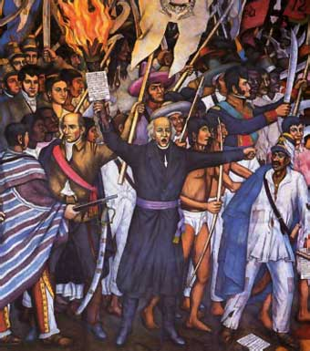
How would independence be achieved?
Haiti Slave Revolt Led by Toussaint L’Ouverture, 1791-1801
Great Liberator of New Grenada, Simon Bolivar, 1806 – 1825
Mexican revolt, Father Miguel Hidalgo, 1810-1811 (*1821)

Slide 7
Great Liberator, Simon Bolivar
“We are sent to destroy the Spaniards, to protect the Americans, and to reestablish the republican governments… the states defended by our arms are again governed by former constitutions and tribunals, in full enjoyment of their liberty and independence…”

Slide 8
Independence & Freedom
“Not the Spanish, but our own disunity led us back into slavery. A strong government could have changed everything.”
Simon Bolivar, Venezuela, 1812

Slide 9
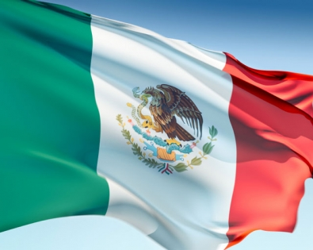
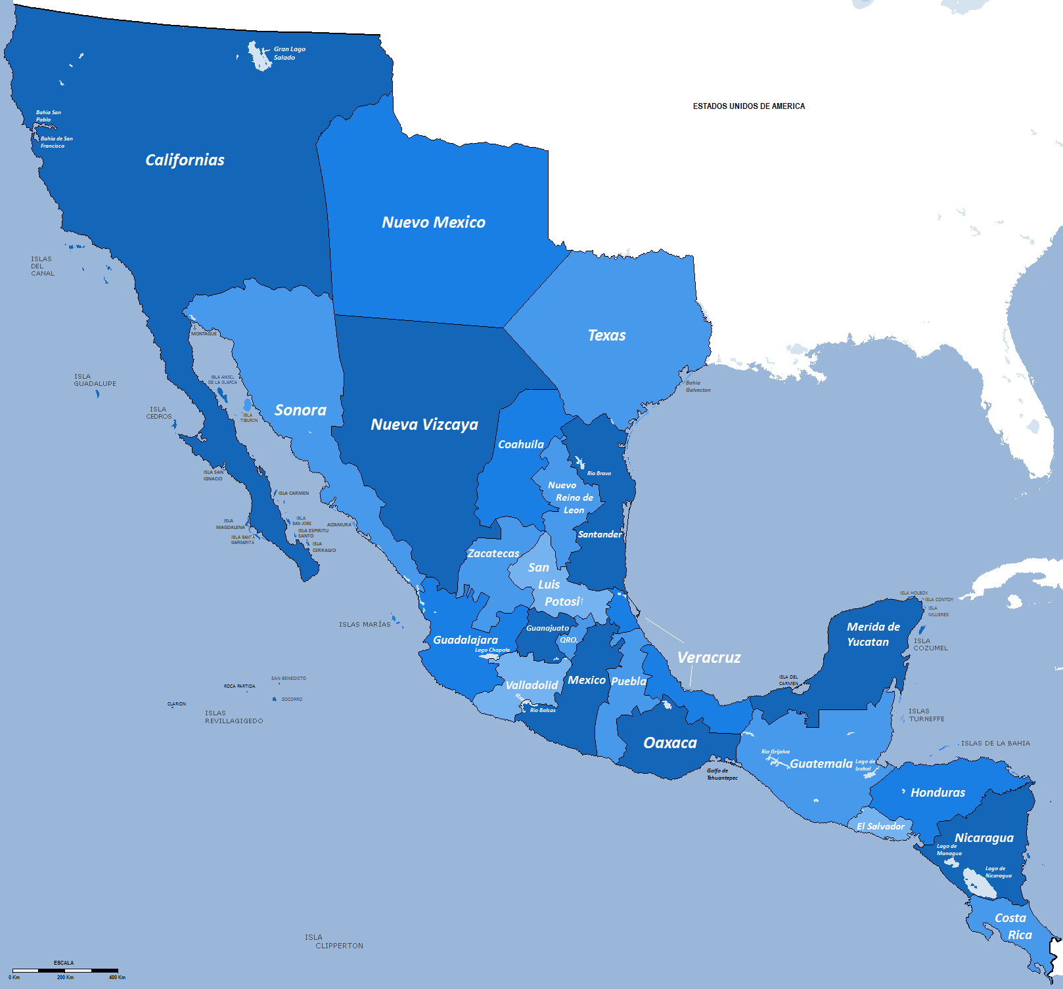
Mexico’s Fathers Hidalgo & Morelos
MEXICO…
“… in addition to a war of national liberation,
… was also an internal war pitting classes and ethnic groups against each other, an intensely localized struggle by rural people”

Slide 10
Revolutionary?
Father Morelos’ manifesto:
Roman Catholicism Official Religion
Sovereignty of the People
American-born eligibility for Public Employment

Slide 11
Age of Anarchy 1822-1855
Mexico’s , Caudillos & Regionalism
38 Changes in Power
23 Different Leaders

Slide 12
Sugar Kingdom: Cuba’s Gold
What is the context of the Western World 1850s to century’s close?

Slide 13
Sugar is KING!
“The biggest sucrose consumers, especially after 1850, came to be the poor, whereas before they had been the rich… Cheap sugar, the single most important addition to the British working class diet during the nineteenth century, now became paramount…on average nearly one sixth of per capita caloric intake.”
- Sidney Mintz, 2001

Slide 14
Neocolonialism
“L” Liberalism
Positivism
Modernistas

Slide 15
Responses: Cuba & Mexico
Cuban Wars for Independence 1868-1898
Jose Marti, Modernista & Cuban Patriot
Rise of Mambisas, Women Revolutionaries
Porfirio Diaz, President 1876-1911
Positivist: Order & Stability
Modernization at a cost: Prompt Mexican Revolution

Slide 16
Questions Considered…
How does historical paradox hinder “modernization” in Latin America?
What constitutes modernization?
Can democracy work in Latin America?
Will democracy or capitalism promote peace and development in the region?

