Slide 1
Marie Antoinette

Slide 2
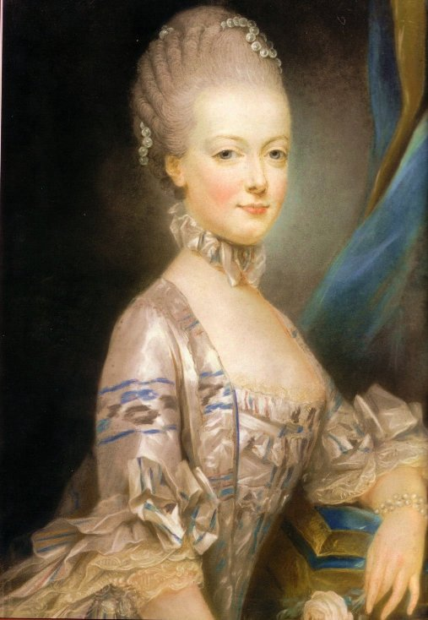
Marie Antoinette

Slide 3
History of Marie Antoinette
Marie Antoinette was born November 2, 1755
She was born in Vienna, Austria
She was the youngest and most beautiful daughter of Francis Stephen l and Maria Theresa
She married the crown prince of France in 1770
Four years later she became queen when her husband was crowned king Louis XVI (House of Bourbon)

Slide 4
Motherhood
Her children (Marie Therese and Louis XVII) were taken from her
Her son Louis XVII was subjected to abuse by the family's jailers and later died
Marie Therese, her firstborn daughter was the only family member to survive

Slide 5
Declining popularity
Instead, after the death of the comte de Maurepas, the influence of Vergennes was strengthened, and she was again left out of political affairs
When accused of being a "dupe" by her brother for her political inaction, Marie Antoinette responded that she had little power
Her temperament was more suited to personally directing the education of her children witch was against the traditions of Versailles

Slide 6
The Queen’s Fate
After her husband’s death, in July 1793, Marie Antoinette’s son was forcibly taken from her
In September 1793, Marie Antoinette was separated from her daughter and sister in law
On October 14, the poor pallid woman was awoken at night and faced the Revolutionary Tribunal, the trial was a horror, with the Queen attacked more as a person than as a queen

Slide 7
Diamond Necklace Affair
By the mid 1780s tales of the queen’s extravagance, dissipation and sexual vice abounded
The affair fused three disparate situation, united by widely held beliefs in the loose morals of Marie Antoinette

Slide 8
Fall of the Bastille
Louis lacked the will to quell this rebellion but was repeatedly lobbied to take action by Marie Antoinette
In July, a mob of commoners seized the Invalides and obtained a supply of fire arms
Louis failed to take prompt action and the mob succeeded in taking the Bastille

Slide 9
Death of Marie Antoinette
Marie death occurred on October 16, 1793
Marie Antoinette was 38yrs old
The body of Marie Antoinette was harshly pushed on to the guillotine plank, her head placed in the vice and at noon the blade fell to loud cheers all round
The body of Marie Antoinette was left on the grass before being dumped in an unmarked grave

Slide 10
Questions
How did Marie Antoinette die?
How old was she when she died?
When was she born?
Who was her husband?
Where was she born?

