Slide 1
Jean-Paul Marat
Jacob Kibler
D-2

Slide 2
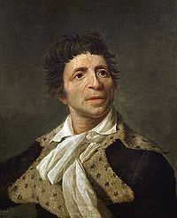
Born in the Principality of Neuchatel on May 24 1743.
He was a Physician, a Political Theorist, and a Scientist best known for being a radical journalist during the French revolution.

Slide 3
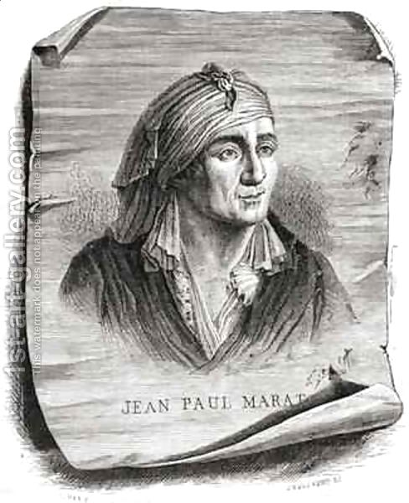
His journalism was known for its uncompromising view in the “Enemies of the Revolution”.
He became one of the more extreme journalists of the revolution.
He became a defender of the Sans-Culottes.

Slide 4
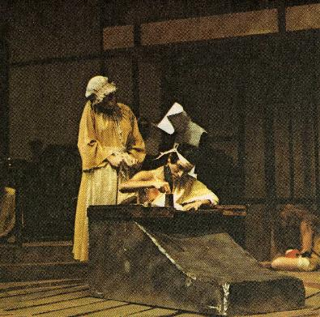
Jean-Paul had a special skin condition called dermatitis herpetiformis.
Because of that, he had to spend most of his time in his bathtub which had certain minerals to help ease the pain.
He also wore a Vinegar soaked bandana to help reduce discomfort.

Slide 5
In September 1789 he began his own paper called Moniteur Patriote (Patriotic Watch).
Four days later he changed it to Publiciste parisien.
Then finally to Friend of the People.

Slide 6
He often wrote about people who he thought were in Power and made them “Enemies of the People”.
Although he was making people in power “Enemies of the People”, he never really chose a side.

Slide 7
Usually Marat attacked the most powerful and influential groups in France.
In January 1790, he moved to the radical Cordeliers section, then under Danton and was nearly arrested.

Slide 8
After nearly being arrested, he was forced to flee from London, where he wrote Denunciation of Jacques Necker.
Denunciation of Jacques Necker was an attack on Louis XVI’s Fiancé Minister.
He then returned to Paris to finish L'Ami du Peuple.

Slide 9
C'en est fait de nous!
C'en est fait de nous Or We’re Done for was a pamphlet He wrote on July 26 1790 about Conservative Revolutionary leaders.
“Five or six hundred heads would have guaranteed your freedom and happiness but a false humanity has restrained your arms and stopped your blows. If you don’t strike now, millions of your brothers will die, your enemies will triumph and your blood will flood the streets. They'll slit your throats without mercy and disembowel your wives. And their bloody hands will rip out your children’s entrails to erase your love of liberty forever.”

Slide 10
Marat was chosen to go to the National Convention in September 1792 as one of the Paris Deputies.
Even though he was one of the Paris Deputies, he wasn’t part of any party.

