Slide 1
Greek arts
By James Mayse and Will Clarke

Slide 2
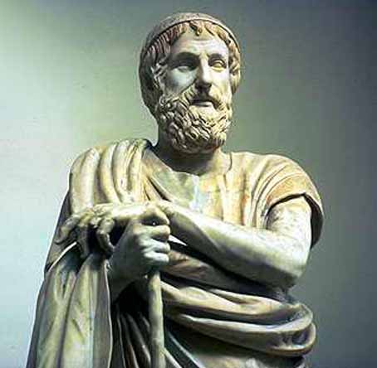
Homer
Blind Poet
Credited with the dramatization of The Illiad and The Odyssey
These told of the Trojan War and of Odysseus’ journey back home.

Slide 3
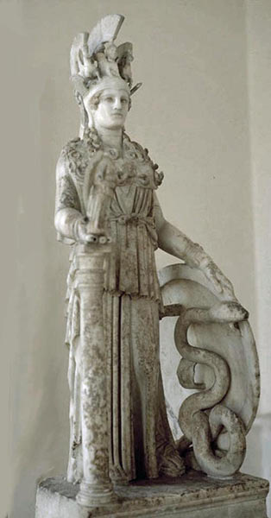
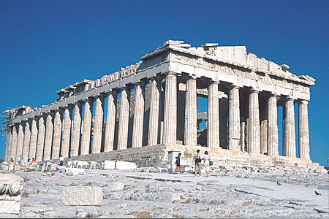
Parthenon
Temple to Athena, Patroness of Athens
A triumph of architecture
Had a Frieze along the side of it to tell the story of Athena’s birth.

Slide 4
Pottery
Mainly for practical purposes over decoration.
Started with basic geometric shapes, but then moved into more realistic shapes.

