Slide 1
French Revolution at its Height
By: Khari Lomax
Marianna Hill

Slide 2
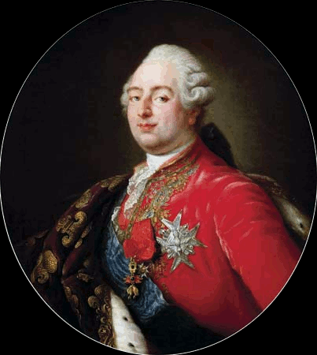
The French Revolution Begins
*Louis XVI was a weak leader and lived life extravagantly when people were starving. This made the people of France angry.
*Enlightenment’s ideas began to surface and spread throughout France, causing people to refer to the Old Regime as unfair, for they believed that all men should be created equal.

Slide 3
The Three estates
*The 3 estates were as follows
First estate~ the Roman Catholic Church’s clergies; they owned 10% of the land in France; provided relief services to the poor and donated 2% of income to the government.
Second estate~ the rich nobles; were 2% of the population but owned about 20% of land and paid very little taxes
Third Estate~ About 97% of population, lacked privileges and paid high taxes.
Bourgeoisie(Middle Class)-bankers, factory owners, merchants, etc.
Workers-poorest group in France; paid very low wages by their employers, included laborers
Peasants-France’s largest group with more than 80% of the french people. Paid about half their earnings to the church and the government

Slide 4
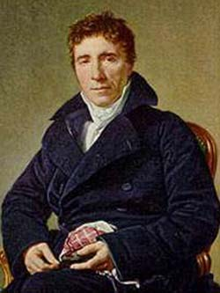
1789
*The third estate’s delegates were determined to gain power, despite the unfairness of the other two estates having more power than them by having the advantage of more votes.
*Sieyes suggested that the third estate delegates call themselves the National Assembly, which was agreed to by a majority. On June 17, 1789, they voted to officially establish the National Assembly. This was the first act of deliberate revolution.
Sieyes

Slide 5
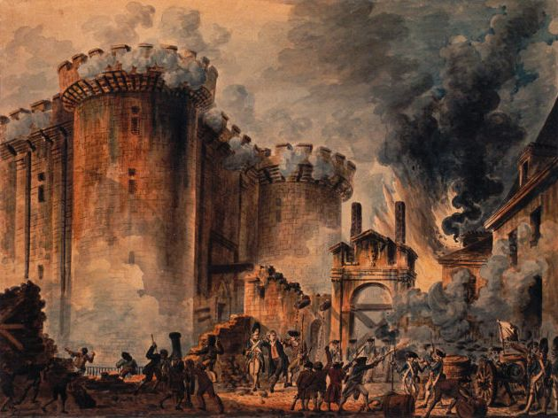
The Tennis Court Oath- The Third Estate’s Delegates were locked out of the meeting room, and entered an indoor tennis court, pledging not to leave until they created a new Constitution
*Storming The Bastille-On July 14, a mob stormed the Bastille searching for gunpowder. The fall of the Bastille-July 14-is now a French holiday
Storming of the Bastille

Slide 6
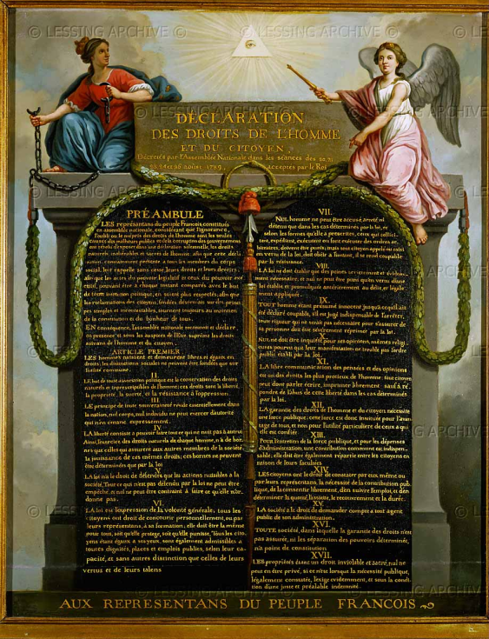
Changes of the Assembly
*Rights of Man- “People are born and remain free and equal in rights”
*The Catholic Church became state controlled
*In June 1791, Louis XVI’s family attempted to escape as his fate as a monarch was questioned
*Limited Monarchy and a legislative assembly was formed
The Declaration of the
Rights of Man

Slide 7
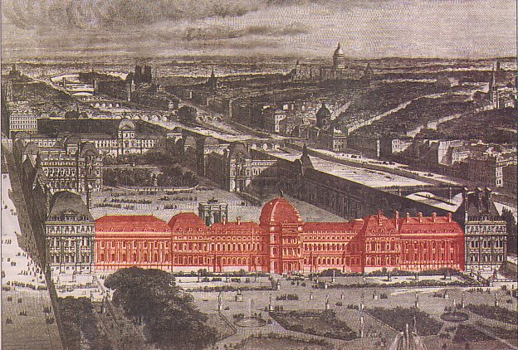
1792
War
*Prussian forces threatened to destroy Paris if anybody of the royal family was hurt. Because of this, the royal family was kidnapped from Tuileries and imprisoned.
The war continued with France facing many rivals, including Prussia and Austria
Tuileries palace

Slide 8
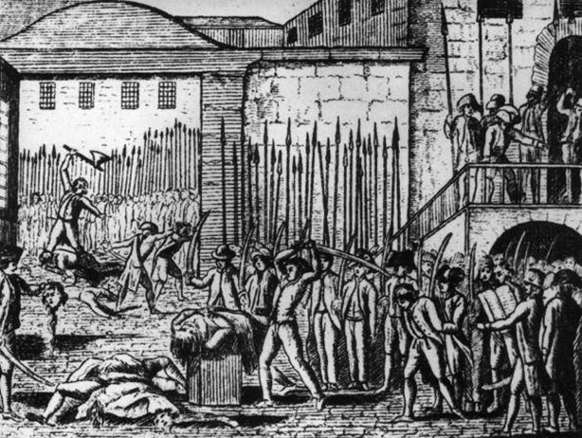
The September Massacres
*The French were worried about those in prison who supported the king escaping so they took the law into their own hands
*For a few days in September, they raided the prisons and murdered over 1,000 prisoners.

Slide 9
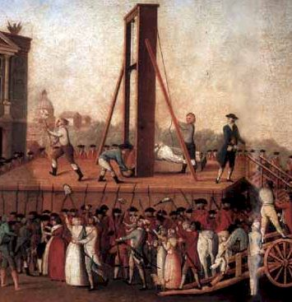
The Guillotine
*The Guillotine was created by Joseph Ignace Guilotin
*Form of capital punishment and introduced in 1792
*Beheaded many citizens and royals, including Louis XVI and Marie Antoinette
The Guillotine

Slide 10
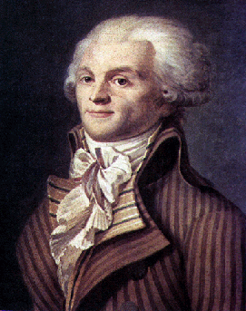
Robespierre
*1793, gained power
In July 1793, he became the leader of The Committee of Public safety
*Eventually, he governed as a dictator and this period became known as the Reign of Terror
*Killed anybody he saw as a danger to his beliefs

Slide 11
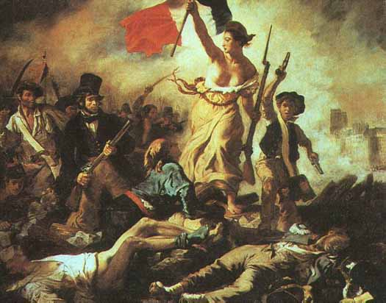
Reign of Terror
The Name given to the period when the most citizens in France were killed by the Guillotine

Slide 12
http://english13.wordpress.com/2011/09/10/the-camargue-invention-of-tradition/
http://www.thrale.com/image/king_louis_xvi_france
simplistic-reflection.blogspot.com
http://www.lessing-photo.com/dispimg.asp?i=26030344+&cr=2&cl=1
http://wirednewyork.com/forum/showthread.php?t=10316
http://stevewyattlafleur.wordpress.com/category/uncategorized/
http://europeanhistory.about.com/od/thefrenchrevolution/ig/Pictures-from-the-French-Revolution/The-September-Massacres.htm
http://www.historywiz.com/historymakers/robespierre.htm

