Slide 1
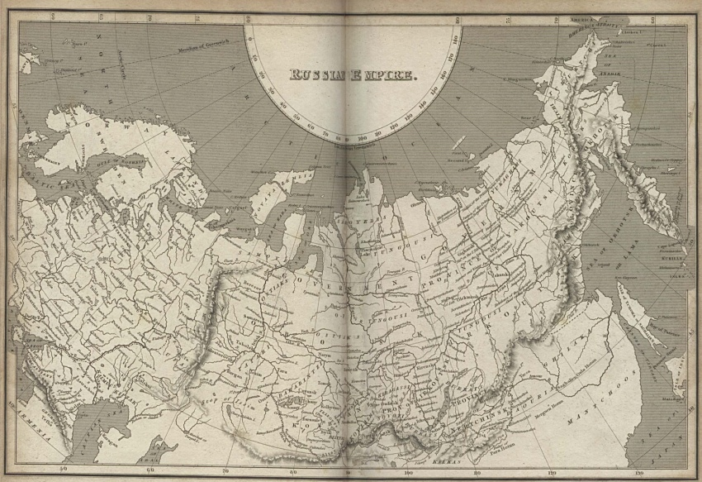
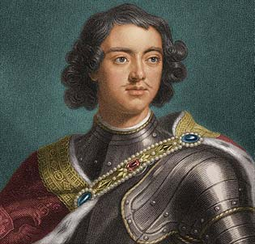
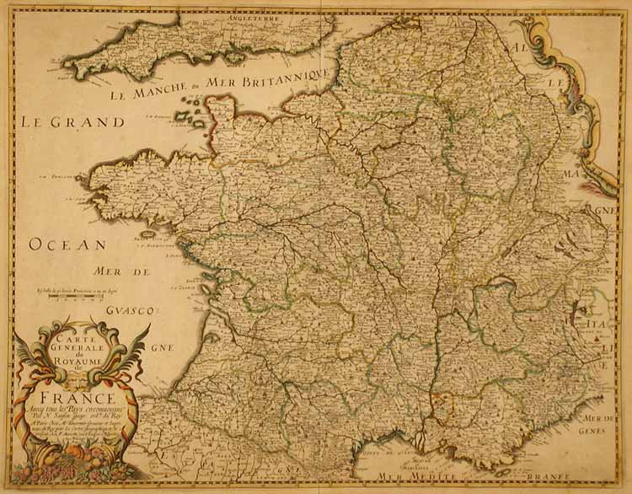
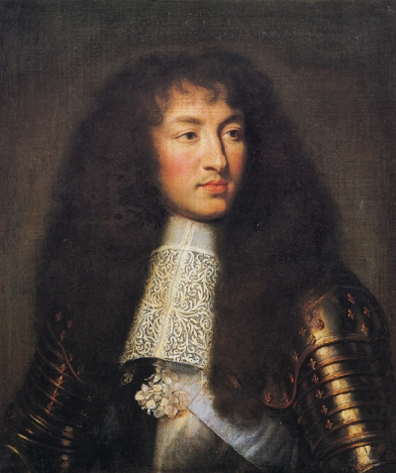
Exploring Absolutism
1600-1800 Absolutists: Comparison of P.E.R.S.I.A.
Kimberly Agosto
AP World History
Mr. DeMott
Louis XIV
Peter I
the Great

Slide 2
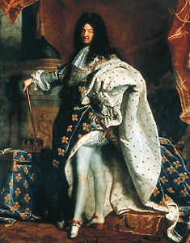
Louis XIV: Introduction
King of France (1643-1715)
Longest reign in modern European history.
Alias:
“Dieudonne” (God-given)
“Grand Monarch”
“Louis the Great”
“Le roi-soleil” (The Sun King)
Made France most powerful country in Europe.
Set the standard throughout Europe for administration, war, diplomacy, language, thought, literature, music, architecture, fashion, cooking, and etiquette.

Slide 3
Louis XIV: Political
Boasted “L’état, c’est moi” (“I am the state”).
By 1690, Louis XIV raised an army of 40,000 men:
equal to combined armies of England, the Habsburg Empire, Prussia, Russia, and the Dutch Republic.
French navy was larger than the English: 120 compared to 100.
Growth of France disturbed the “balance of power”.
Gained important territories, formed alliances with other countries.
The war of the League of Augsburg (1688-97) and the War of the Spanish Successsion (1702-13) reduced France’s power.
Forced to cede to Britain the North American colonies of Newfoundland and Nova Scotia and all French claims to the Hudson Bay territory.

Slide 4
Louis XIV: Economical
Louis’ chief economic adviser, Jean-Baptiste Colbert, pursued policy of mercantilism:
He did this by strengthening state control over the national economy.
To facilitate trade, he abolished local taxes on trade throughout central France.
Established Commercial Code to unify business practice throughout the country.
To improve communication, he built roads and canals.
Set quality standards for hand manufacturers to improve their marketability and gave financial incentives to them of such luxury goods:
i.e. silks, tapestries, glass, and woolens.
Needs of the army created huge national markets for uniforms, equipment, and provisions.
All these policies benefited private business and the state.
Growth of French economic strength was also a contributor to the disturbing of “balance of power”.

Slide 5
Louis XIV: Religious
His leading religious adviser, Bishop Jacques-Bénigne Bossuet, linked the king’s power to divine right:
Asserting that “Royalty has its origin in the divinity itself.”
Continued the right of the king to appoint the Catholic clergy in France.
In 1685, he revoked the Edict of Nantes, believing that a single dominant religion was more important than minorities.
This cost France the service of many Protestant artisans, who fled to Netherlands and Britain.
These Protestants were called Huguenots.

Slide 6
Louis XIV: Social
Louis XIV ruled by collaborating with socially powerful elites.
As suggested of his absolute monarch title, he gives great privilege to the nobility.
He gained support of his rule through winning favor of the nobility.
The most prominent nobles could live in Versailles with their families and entourages.
Of course, other peoples, especially those who work under the arts can gain benefits from the king as to work with the king and performing whatever the king desires.
i.e. painters, sculptors, architects, and writers

Slide 7
Louis XIV: Intellectual
Louis XIV allowed classical French literature to flourish by protecting such writers:
Molière, Jean Racine, and Jean de La Fontaine.
His secret wife, Madame de Maintenon, advised Louis to sign letters patent creating the “Institut de Saint-Louis” at Saint Cyr for “filles pauvres de la noblesse” (“for poor noble girls”) between the ages of seven and twenty.
Saint Cyr was at the time the only educational institution for girls in France that was not a convent.

Slide 8
Louis XIV: Artistic
Supported writers and artists and played a part in the growth of French literature.
Historians described Louis’ long reign as “century of Louis XIV”.
With his built palace at Versailles, he himself was the arbiter of taste and style.
He lavishly patronized painters, sculptors, architects, and writers who creations met with his approval.
Nobles living at Versailles mastered the intricacies of court ritual and attended banquets, concerts, operas, balls, and theatrical performances.
During this, Louis and his ministers run the state.
Louis provided nobility with luxurious accommodations and endless entertainment in exchange for absolute rule.

Slide 9
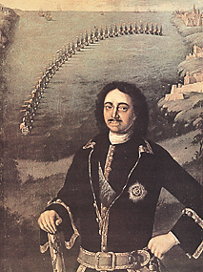
Peter I the Great: Introduction
(1682-96) Co-emperor with his half-brother.
(1696-1725) Became sole emperor.
Member of the Romanov dynasty.
Transformed Russia into great European power.
Imposed Western customs on Russia.

Slide 10
Peter 1 the Great: Political
Humiliated by Swedish defeat at the Battle of Narva in 1700, he set out to construct a powerful state based on a powerful army and navy.
In 1697, Peter embarked on a “Grand Embassy of Western Europe”.
He searched for allies for wars he expected against the Turks.
Gathered information on the economic, cultural and military-industrial practices of Western European powers.
Impressed by their strength, Peter invited western military experts to train and lead his troops.
Bought western European artillery and copied it.
Established naval forces and reorganized the army along Western lines in uniformed regiments, armed with muskets.
Promoted mining, metallurgy, and textile manufacture (largely to provide his troops).
Built a new capital (an all-weather port and “window on the west”) in St. Petersburg
Ironically, land that he conquered from Sweden.
Modeled St. Petersburg as a Western city.
When Sweden invaded Russia again, Peter was prepared and defeated the Swedish troops.

Slide 11
Peter I the Great: Political pt. 2
Created a new system of administration with himself as head.
He streamlined local and central government.
Created a new “state service”, including both civil and military officials, and made appointments to it completely without regard to family status, birth, or seniority.
Foreigners could serve within this service, serfs could be elevated, and nobles could be demoted. All depended on performance.
1722- introduced new Table of Ranks, which automatically gave noble status to officials who reached the 8th out of 14th position.
The newly elevated nobility were the chief administrators of Peter’s new policies of Westernization.

Slide 12
Peter 1 the Great: Economical
Pushed for the creation of new enterprises.
He built a fleet on the Baltic and encouraged exports.
Organized new companies headed by groups of Russians and foreigners and supplied them with working capital and serf laborers.
Accepted mercantilist concept of an economically strong state but saw no role for free market.
To finance these state-organized initiatives, Peter introduced heavy taxes.
Conscription, programs of forced labor, a poll tax, and indirect taxes on everything from bee-keeping to salt provoked two major uprisings in the Russian interior between 1705 and 1708.
The czar suppressed them brutally.
An iron-willed autocrat, Peter bought his nation into Europe and made it an important economic (and military) power, but millions of Russians paid a terrible price.

Slide 13
Peter 1 the Great: Religious
He bought the Eastern Orthodox Church under state control and subordinated its clergy to his own leadership.
This thus abolished independence of the church.
In addition, this makes the state outweigh the influence of the church for it has total power of it.
Primary goal of Peter is to impose western European’s religious custom, which is predominantly Christianity.

Slide 14
Peter I the Great: Social
The drive to “westernize” Russia bought many social impositions on the nobility.
Only nobles learn western-style education.
Peter demanded that aristocrats acquire morals and tastes of Europe’s elites.
He made them abandon their Russian dress in favor of the clothing of western Europe and forced the men to shave or trim their beards in the Western style.
These revolutionary reforms drove a wedge between the nobility and the mass of Russians.
Peter strengthened the political and economic position of the ruling classes, the landowners, and the rising bourgeoisie while exploiting the peasantry ruthlessly.

Slide 15
Peter 1 the Great: Intellectual
Peter required Western-style education for all male nobles.
He established schools for their children and sent many to study in western Europe.
He introduced “cipher schools” for teaching basic reading and arithmetic, established a printing press, established and edited Russia’s first newspaper and funded the Academy of Sciences, which opened in 1724.
He also founded technical schools, museums, and a public library.

Slide 16
Peter 1 the Great: Artistic
St. Petersburg, a seaport that Peter opened in 1703, served as a magnificent capital city and haven for Russia’s navy.
Artistic-wise, it serves as the ideal model or “picture” of a western society, which he greatly wishes to impose on Russia in hopes of strengthening his country.
In addition, from his “Great Embassy”, he founded an art gallery that displayed western customs.

Slide 17
Citations
Ultee, Maarten. "Louis XIV." World Book Student. World Book, 2009. Web. 6 Oct. 2009.
Cracraft, James. "Peter I, the Great." World Book Student. World Book, 2009. Web. 7 Oct. 2009.
"Louis XIV of France." http://en.wikipedia.org/wiki. Wikipedia, the Free Enyclopedia, 6 Oct. 2009. Web. 7 Oct. 2009. <http://en.wikipedia.org/ wiki/Louis_XIV_of_France#Patronage_of_the_arts>.
BENTLEY, JERRY H., and HERBERT F. ZIEGLER. "A Global Perspective on the Past." Traditions & Encounters. Third Edition ed. [c. 2006?]. Print.
Spodek, Howard. "Combined Volume." The World's History. Third Edition ed. [c.2006?]. Print.

