Slide 1
Absolutism and revolution
Austin Taylor J-1
Khiree Bland J-2
Paris J-3

Slide 2
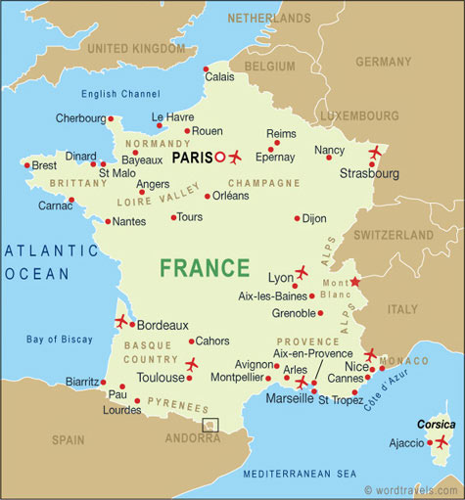
People of France

Slide 3
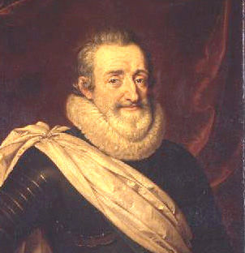
Henry IV – he tries to restore France but fails

Slide 4
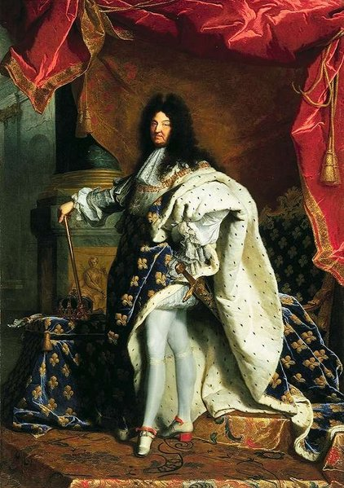
Louis XIV – had a philosophy of ,“I AM THE STATE”, also know as Louis the great or The Sun God, built the palace of Versailles, negotiated the peace of Westphalia

Slide 5
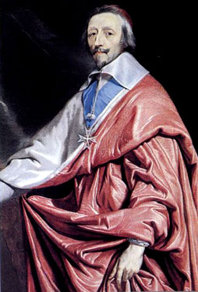
Cardinal Richelieu – increased power of the monarchy, increased power of government agents, and involved France in the 30 years war

Slide 6
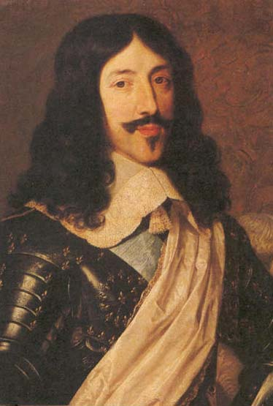
Louis XIII – he was a weak leader and appointed a strong leader named cardinal Richelieu

Slide 7
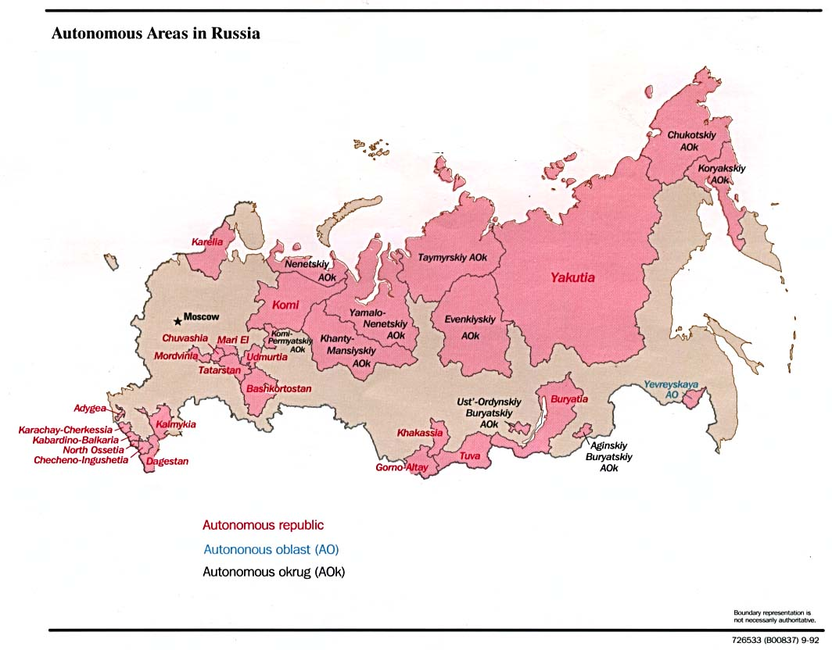
People of Russia

Slide 8
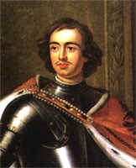
Peter the great – had the idea of modernizing Russia

Slide 9
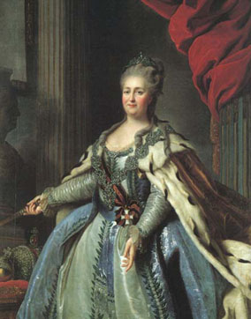
Catherine ii - was the most renowned and the longest-ruling female leader of Russia

Slide 10
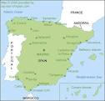
People of Spain

Slide 11
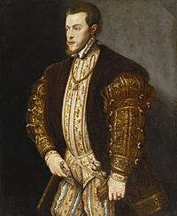
Philip II – or known as Philip the prudent. He inherited Spain, the Spanish Netherlands, and the American colonies.

Slide 12
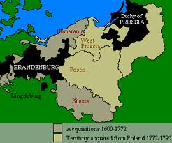
People of Prussia

Slide 13
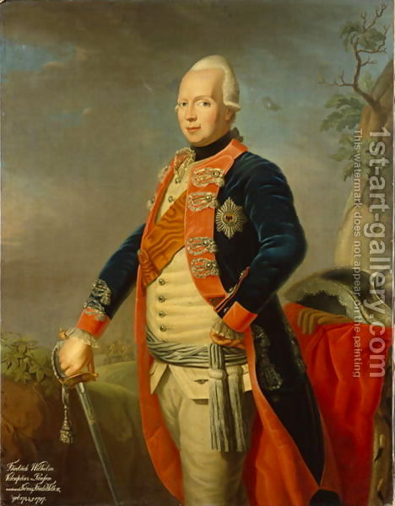
Frederick William II –removed the ban on the German language

Slide 14
Concepts

Slide 15
Revolution - is a fundamental change in power or organizational structures that takes place in a relatively short period of time.

Slide 16
Absolutism -A political theory holding that all power should be vested in one ruler or other authority

Slide 17
Age of enlightenment-when people began to think for themselves other than having people tell them what to think.

Slide 18
Monarchy- is a form of government in which the office of head of state is usually held until death or abdication and is often hereditary and includes a royal house.

Slide 19
Questions ?
1: who tries to revive France?
2: who increased power of the monarchy?
3: who had a philosophy of “I am the state”?
4: What is a monarchy?
5: what is the age of enlightenment?

Slide 20
Questions (continued)
6: What is absolutism?
7: What is a revolution?
8: Who is Frederick William II?
9: Who is Phillip II?
10: Who is peter the great?

Slide 21
http://www.virtualclassroom. net/tvc/frab/sld001.htm www.Traditioninaction.org www.google.com www.worldtravels.com

