Slide 1
2nd half of Chapter 6: ARTS
By:
Bryony Jimenez
Elizabeth Muller

Slide 2
The End of the Roman Republic
Hadrian (117-138 CE) created a wall that stretched from west to east in the narrowest northern part of Britain.
25 years later Antonius Pius (138-161 BCE) created a second wall just 50 miles north from where the original wall was
This marked the edge of Roman territory

Slide 3
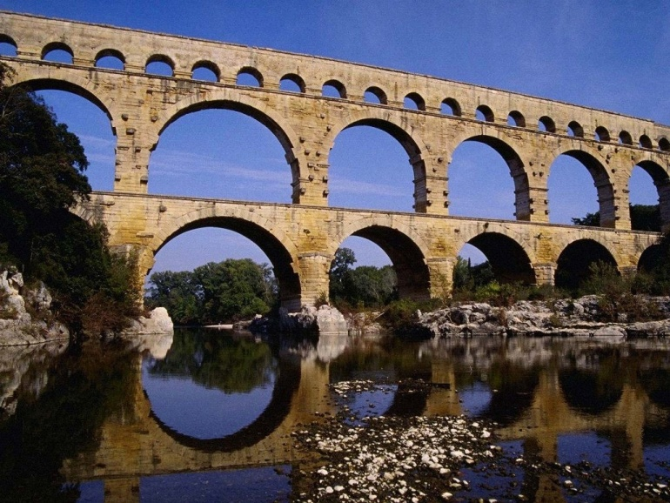
Art in the form of Architecture
Romans claims on important cities gave those cities
Important architectural influence. Cities like London,
Paris, Lyons, Trier, Nimes, Barcelona, etc had evidence
of Roman art in the form of architecture
Roman Aqueducts were used as ways of irrigation

Slide 4
How Rome is a copycat in the Arts
When Rome conquered Greece it adopted the culture. This is called Hellenistic culture
They adopted the art styles, languages, and architecture.
Romans invented concrete, which was used in many art pieces.
All this mean Rome was a copycat to Greece

Slide 5
The use of trade to benefit Roman Art
Luxury trade with India made the Romans use different shades of color and the use of spices to creates plates and pottery.

Slide 6
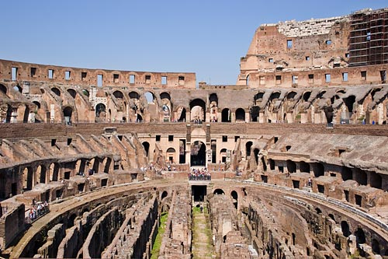
Roman Coliseum
The Roman Coliseum was a large
round building that held many gladiator
Fights, mock sea battles, and even
Executions. This piece of art in
architecture still stands and is still
Admired by thousands daily

