Slide 1
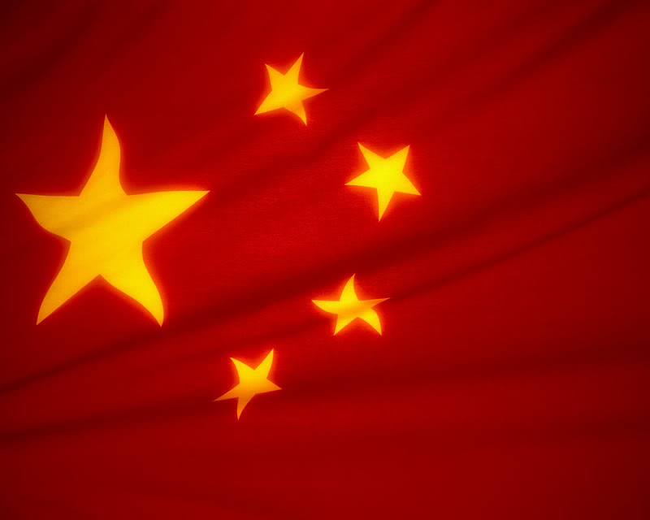
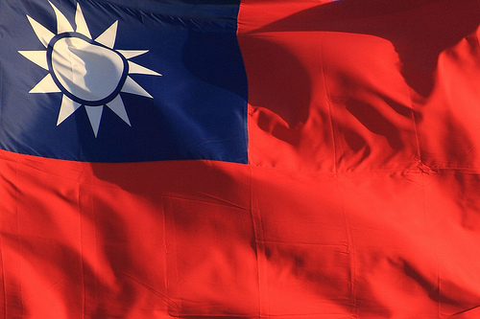
Difference in Governments
People’s Republic of China v. The Republic of China
By: Jose Baez and EDM

Slide 2
Terms:
Democracy: form of government in which all citizens have an equal say in the decisions that affect their lives.
Totalitarian: of or pertaining to a centralized government that does not tolerate parties of differing opinion and that exercises dictatorial control over many aspects of life.
Communism: a theory or system of social organization based on the holding of all property in common, actual ownership being ascribed to the community as a whole or to the state.

Slide 3
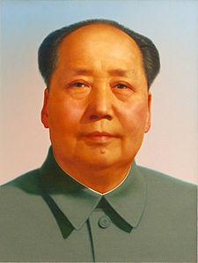
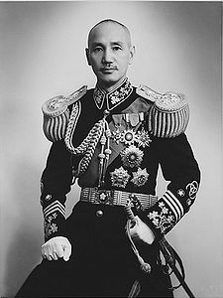
Chinese Civil War Mao Zedong’s Communist Party of China vs. Chiang Kai-shek’s Nationalist Party of China (Guomindang)
Both sides fought for control of all of China which eventually led to the split into two Chinas.
The People’s Republic of China was created on mainland China.
The Republic of China of China was created on the island of Taiwan.
Chairman Mao Zedong came out victorious and General Chiang Kai-shek’s forces fled in exile to the island of Taiwan and established a new government.
Both governments claim sovereignty over all of China as stated in their constitutions.

Slide 4
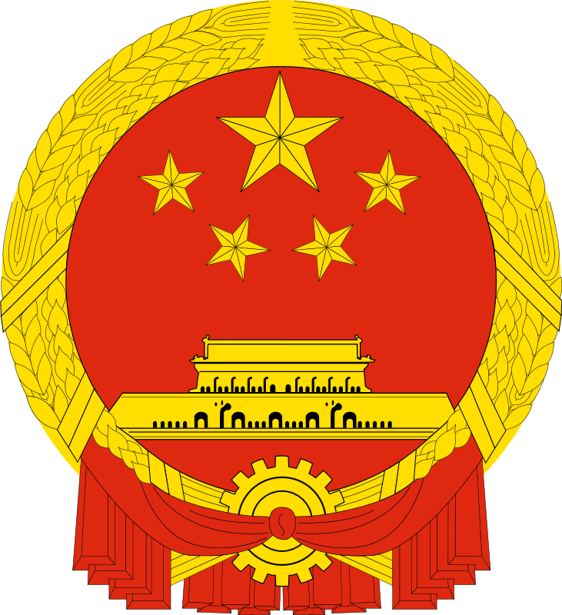
People’s Republic of China
Today China is theoretically a communist state.
A single party state; Ruled by the Communist Party of China
Communist Party is enshrined in the constitution.
Legislative Branch
National People’s Congress; 2,987 seats
Unicameral
Communist Party of China by law keeps overwhelming majority in Legislative body.
There are other parties that hold a small number of seats in the NPC like the coalition of the United Front of Democratic Parties, but this is only to give the illusion of
democracy and change.
Executive Branch
Chief of State: President Hu Jintao
Head of Government: Premier Wen Jiabao
President elected by NPC for a 5 year term
Hu Jintao elected president by NPC with a total of 2,963 votes.
Premier nominated by president, confirmed by NPC.
Judicial Branch
Supreme People’s Court
Judges appointed by the National People's Congress

Slide 5
The People’s Republic
On October 1, 1949, Mao Zedong proclaimed the People's Republic of China.
Mao Zedong’s Great Leap Forward.
The economic and social plan resulted in an estimated 45 million deaths.
Aimed to use China's vast population to rapidly transform the country from an agrarian economy into a modern communist society through the process of agriculturalization, industrialization, and collectivization.
Ended in catastrophe with millions left dead and diseased.
In 1966, in panic and retaliation against those party opposition, Mao Zedong launched the Cultural Revolution.
The Great Proletarian Cultural Revolution:
Motivated by power struggles within the Party and a fear of the Soviet Union.
Designed to further advance socialism in the country by removing capitalist elements from Chinese society, and impose Maoist orthodoxy within the Party. The movement brought chaos, as social norms largely evaporated and the previously established political institutions disintegrated at all levels of government.
Was also catastrophic and brought chaos.
Can be compared to Stalin’s Great Purge.
Led to a mass purge of senior officials who were accused of deviating from the socialist path, most notably Liu Shaoqi and Deng Xiaoping.
The benefits of the Great Leap Forward and the Cultural Revolution are obvious. China has modernized faster than any country in history and is now the 2nd largest economy in the world and is suspected to topple the United States as #1 in the near future.

Slide 6
The Republic of China (Taiwan)
Constitution of the Republic of China: "shall be a democratic republic of the people, to be governed by the people and for the people.“
5 Branches of Government (Yuan)
Control Yuan
Monitors the other branches of government.
Form of Human Rights branch of government.
Examination Yuan
In charge of validating the qualification of civil servants.
Executive Yuan
Headed by the President.
Judicial Yuan
In charge of interpreting the constitution.
Supreme Court
Legislative Yuan
Unicameral legislative body of Taiwan.
Power to create law and amend the constitution.

Slide 7
The Republic
The Republic of China was established on January 1, 1912 on mainland China by Sun Yat-sen , replaced the Qing Dynasty, and ended over two thousand years of imperial rule in China.
The oldest surviving republic in east Asia.
Went through periods of warlords, Japanese invasion, and civil war between the Guomintang (GMT) led Central Government and the Communists.
After the Chinese Civil War and the GMT’s retreat to Taiwan, Chiang Kai-shek and the Nationalist Party continued government as the Republic of China and claimed sovereignty over all of China.
The Republic of China is a democracy that has been declared sovereign by the United States and other allies.
The United States has vowed that it will defend Taiwan in any act of violence against its sovereignty.

Slide 8
http://dictionary.reference.com/
http://www.exam.gov.tw/cp.asp?xItem=9518&ctNode=611&mp=5
http://www.ey.gov.tw/ct.asp?xItem=52759&ctNode=1327&mp=11
http://www.judicial.gov.tw/en/
http://www.ly.gov.tw/en/innerIndex.action
https://www.cia.gov/library/publications/the-world-factbook/geos/ch.html

Slide 9
Consider the following
Answer at least one of the following questions in a full page answer, considering the items on the PowerPoints in this section as well as notes on democracy from the lecture. Be sure to give WHC and examples in your answer.
How does Chinese Communism differ from Soviet Communism?
Why was Southeast Asia such a ripe ground for the battle between Communism and Democracy (thinking about China, Korea, Vietnam, etc.)
Why did Nixon go to China?
Is there such a thing as democracy coming too early? (consider Poland in the age of Absolutism and Afghanistan today)
If many communist movements are populists movements, then aren’t they more democratic than democracies of today? (Consider Guatemala – 1950s, Cuba – 1960s, Venezuela – today, Iran- 1979, Iran – today).
Also, if a dictator is voted in, is s/he not just following the will of the people?

