Slide 1
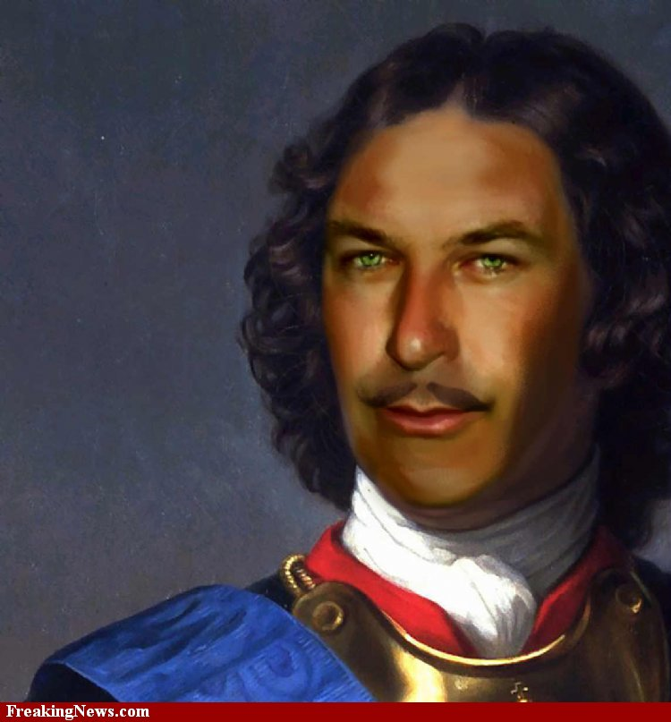
Peter The Great
Dylan Levins
B1

Slide 2
Early Life
Born- June 9th 1672 in Moscow Russia
Died- Febuary 8th 1725 at the age of 52
Father- Alexis I
Mother- Natalya Naryshkina
Religion-Easten Orthodox

Slide 3
Early Years
Peter's education was put in the hands of several tutors most notably Nikita Zotov, Patrick Gordon, and Paul Menesius.
On January 29 1676, Tsar Alexis I died and Peter’s older half brother the weak and sick Feodor III took over the power.

Slide 4
My Time To Shine
Although Ivan V was next in line to the throne after Feodor died he was too ill to rule anything.
So Peter finally got the throne at the age of ten

Slide 5
Conflict
One of Alexis' daughters from his first marriage led a rebellion of the Streltsy which was Russia's elite military corps in April–May 1682
In the conflict some of Peter's relatives and friends were murdered including Matveev
Peter witnessed some of these acts of political violence

Slide 6
Family Matters
Peter the Great had two wives
He had fourteen children
Only three of them survived to adulthood
His eldest child and heir, Alexei, was suspected of being involved in a plot to overthrow the Emperor

Slide 7
Dreamer
Heavily influenced by his advisors from Western Europe Peter reorganized the Russian army along modern lines and dreamed of making Russia a maritime power

Slide 8
That’s an Order
Peter wanted social modernization in an absolute manner by requiring courtiers, state officials, and the military to shave their beards and adopt modern clothing styles

Slide 9
Water control
To improve his nation's position on the seas, Peter wanted to gain more sea port outlets. His only outlet at the time was the White Sea
He wanted the Baltic Sea which was controlled by the Swedish and the Black Sea which Was controlled by the Ottomans

Slide 10
The Great Northern War
Peter made a temporary peace with the Ottoman Empire which allowed him to keep the fort of Azov,
Turned his attention to Russian maritime supremacy.
He sought to acquire control of the Baltic Sea, which had been taken by the Swedish Empire a half-century earlier.
Peter declared war on Sweden which at the time led by King Charles XII.
Sweden was also opposed by Denmark-Norway, Saxony, and the Polish-Lithuanian Commonwealth.

