Slide 1
Music and the Arts

Slide 2
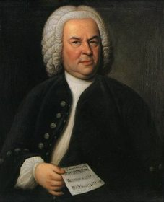
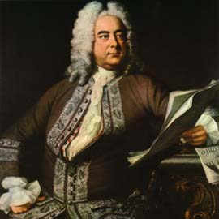
Music changed greatly through the seventeenth and eighteenth centuries
Baroque Period:
Johann Sebastian Bach (1685-1750)
George Frideric Handel (1685-1759)

Slide 3
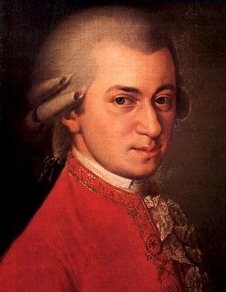
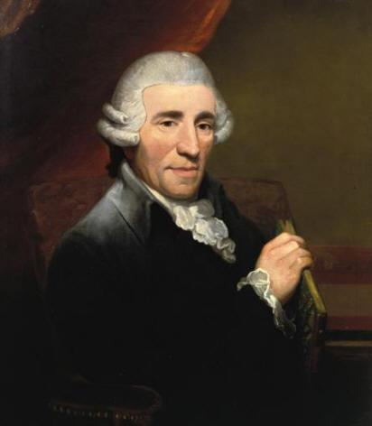
Music changed greatly through the seventeenth and eighteenth centuries
Classical Period:
Wolfgang Amadeus Mozart (1756-1791)
Franz Joseph Haydn (1732-1809)

Slide 4
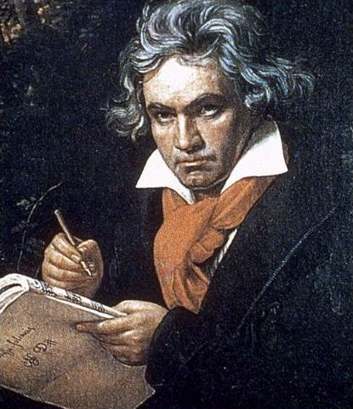
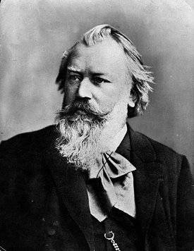
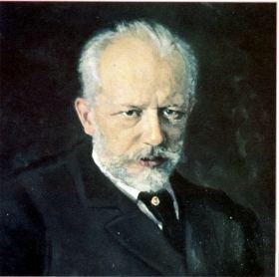
Music changed greatly through the seventeenth and eighteenth centuries
Romantic Period:
Ludwig van Beethoven (1770-1827)
Johannes Brahms (1833-1897)
Peter Ilyich Tchaikovsky (1840-1893)

Slide 5
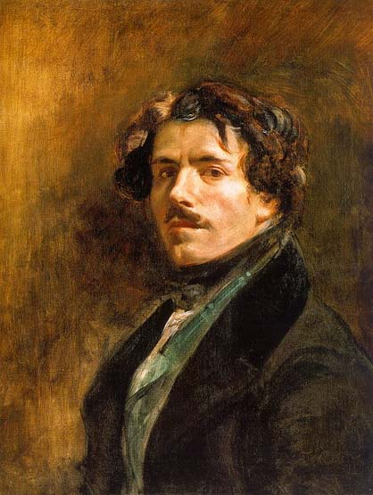
Art of the Romantic Period
One of the most famous painters of the Romantic Period is Eugene Delacroix (1798-1863)
Paintings often depicted the
wonders of nature, landscapes,
deep emotions, and strong
nationalism
They also painted portraits of
living people and major events

Slide 6
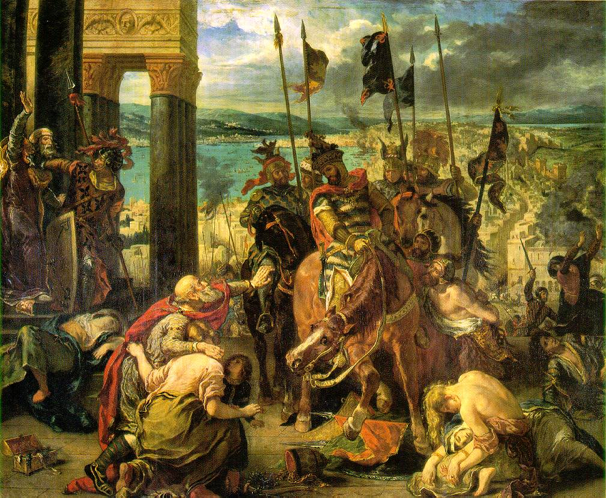
Art of the Romantic Period
Crusaders Enter Constantinople
Liberty Leading the People

Slide 7
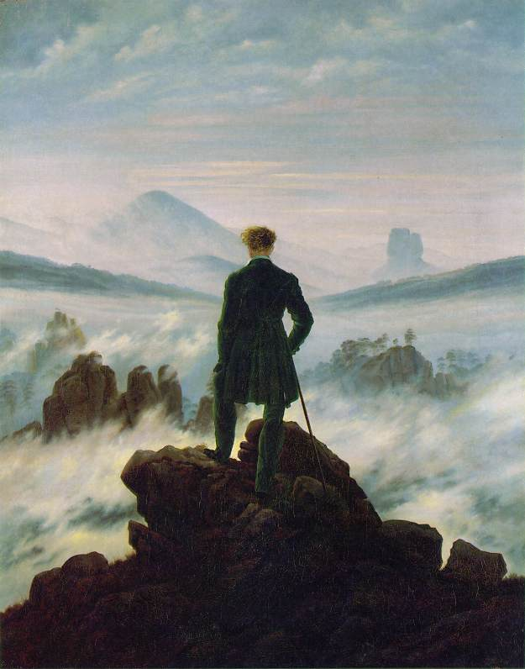
Art of the Romantic Period
Wanderer Above the
Sea of Fog
Chalk Cliffs - Friedrich

Slide 8
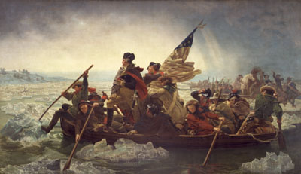
Art of the Romantic Period
Washington Crossing the Delaware
- Leutze
Idyllic English Landscape
- Constable

Slide 9
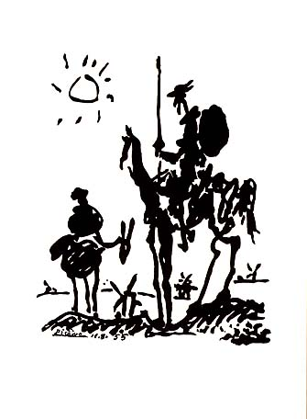
Famous Authors of the Romantic Period
Cervantes developed a new form of literature – the novel.
His most famous work is
Don Quixote, first published in
1605 (vol. I) and 1615 (vol. II).
Miguel de Cervantes

Slide 10
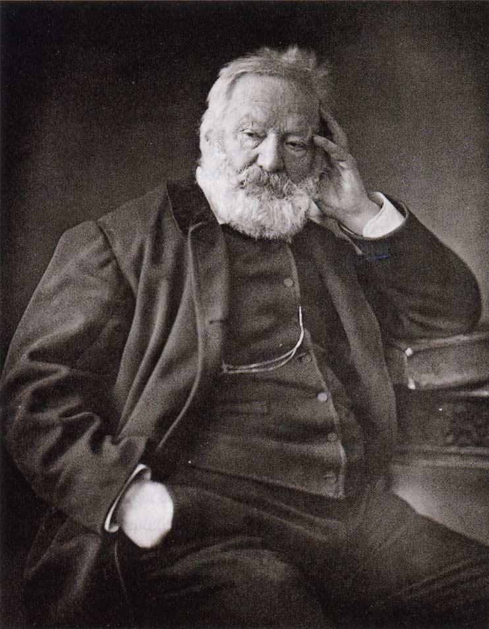
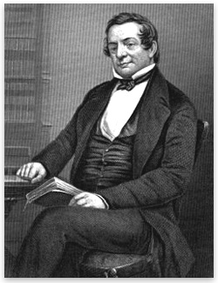
Famous Authors of the Romantic Period
Washington Irving
Mary Shelley
Victor Hugo

Slide 11
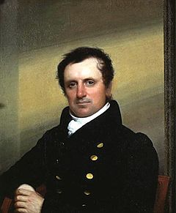
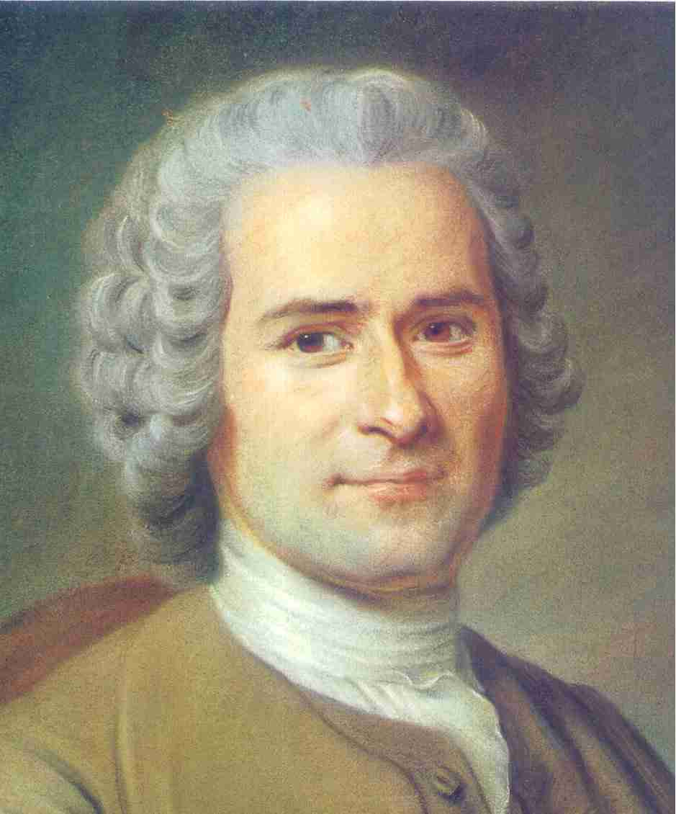
Famous Authors of the Romantic Period
Jean Jacques Rousseau
James Fenimore Cooper
Johann Goethe

