Slide 1
Modern Age & George Orwell
Angeline Kintanar

Slide 2
The Great War
The Great War is later known as World War I happened in 1914-1918.
Great Britain allied itself with France and Russia against the Central Powers of Germany and Austria-Hungary.

Slide 3
The Great war
By the end of The Great War, Great Britain had lost 750,000 lives.
Great Britain spent billions of dollars which sent England into debt and severely rocked the prosperity the nation had formerly enjoyed as a major world power.

Slide 4
World war 2
In the 1930’s, The Great Depression sent the United States and Europe into a crushing economic slump.
Mass employment and poverty led to despair.

Slide 5
World war 2
In a world plagued by financial and emotional crises, dictators were able to rise to power in nations such as Germany, Italy, and Russia

Slide 6
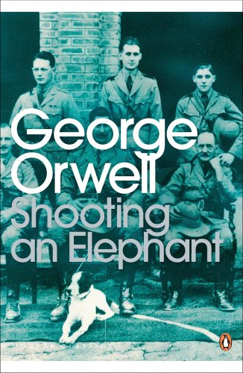
Shooting an elephant
George Orwell - was born Eric Blair on June 25, 1903, in Motihari, Bengal.
Sent to England for his education, Orwell attended St. Cyprians, Wellington College, and then Eton.
Orwell joined the Indian Imperial Police, from which he resigned in 1927, having in the meantime settled on writing as a career.

Slide 7
Shooting an elephant
First published in the literary magazine New Writing in the autumn of 1936, and broadcast by the BBC Home Service on 12 October 1948.
The essay describes the experience of the English narrator, possibly Orwell himself, called upon to shoot an aggressive elephant while working as a police officer in Burma.
Because the locals expect him to do the job, he does so against his better judgment, his anguish increased by the elephant's slow and painful death

Slide 8
The story is regarded as a metaphor for British imperialism, and for Orwell's view that "when the white man turns tyrant it is his own freedom that he destroys”
As an anti-imperialist essayist, Orwell frequently and clearly states his displeasure with colonial Britain.
"I had already made up my mind that imperialism was an evil thing... I was all for the Burmese and all against their oppressors, the British."

Slide 9
Orwell’s hatred
"I had already made up my mind that imperialism was an evil thing... I was all for the Burmese and all against their oppressors, the British."
“All I knew was that I was stuck between my hatred of the empire I served ... I was only an absurd puppet pushed to and fro by the will of those yellow faces behind."

Slide 10
Other works
1984
A Clergyman’s Daughter
Animal Farm
Burmese Days
Coming up for Air
Down and Out in Paris In London
Keep the Aspidistra Flying
Homage to Catalonia
The Road to Wigan Pier
Charles Dickens
Such, Such were the Joys
Decline of the English Murder
Arthur Koestler
A Good Word For The Vicar of Bray

