Slide 1
Latin America SOCIAL THOUGHT
A4
JANICE AGOSTO
JESSICA MANNO

Slide 2
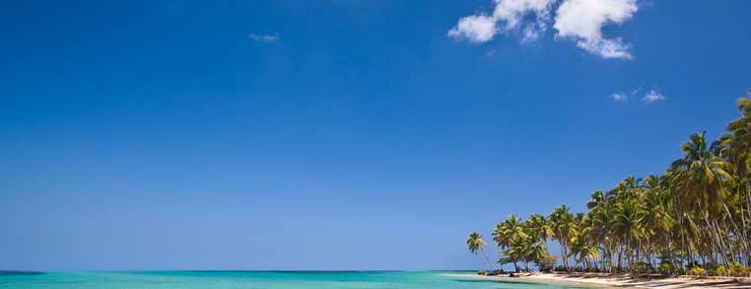
Brief History
In the history of Latin America over the last 500 years or so, the
relationships among three races have been a key factor. In the
beginning, there were the various indigenous groups. Then came the
European colonizers, who later brought black slaves from Africa. The
relationships among these racial groups have at times been violent –
war, slaughter, subjugation, slavery, exploitation, miscegenation, etc.
The administration of the vast colonies was placed in the hands of
nationals of the European empires. These administrators were
rewarded estates for their efforts, and naturally inheritance rights
became a significant issue. As a male may have multiple
children with multiple women, the rights of these apparent
heirs have to be defined, particularly when some of the
mothers were not pure Europeans. Under Spanish rule,
the following detailed caste system was
Instituted in Mexico at one time.

Slide 3
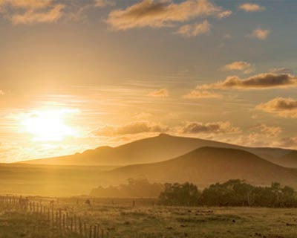
Caste System
-True Spaniards
Full blooded Latino; own property; highest class
-Criollos
Born in America, moved to somewhere in Latin America;
Middle/working class
-Mestizos
At least one parent is true Spaniard; middle/working class
-Indians
Full blood; working class to low class
-Blacks
Slaves; lowest class

Slide 4
Racial Classification
Mestizo: Spanish father and Indian mother
Castizo: Spanish father and Mestizo mother
Espomolo: Spanish mother and Castizo father
Mulatto: Spanish and black African
Moor: Spanish and Mulatto
Albino: Spanish father and Moor mother
Throwback: Spanish father and Albino mother
Wolf: Throwback father and Indian mother
Zambiago: Wolf father and Indian mother
Cambujo: Zambiago father and Indian mother
Alvarazado: Cambujo father and Mulatto mother
Borquino: Alvarazado father and Mulatto mother
Coyote: Borquino father and Mulatto mother
Chamizo: Coyote father and Mulatto mother
Coyote-Mestizo: Cahmizo father and Mestizo mother
Ahi Tan Estas: Coyote-Mestizo father and Mulatto mother

Slide 5
Today, the overt caste systems have been overturned by legislation, but that does not mean that social prejudices and economic exploitation are not present…
People may still hold personal
opinions about members of other
races base upon preconceived
notions.

Slide 6
In Latin America, many possess the ability to classify people into the appropriate racial categories based upon physical appearances…
It’s a simple classification scheme based upon color:
white, black, brown and yellow.

Slide 7
One way to derive a classification system is through self-definition
In 1976, the Brazilian Institute of Geography and
Statistics (IBGE) conducted a study to ask people
to identify their own skin color.
There’s a list of various shades of skin color.
About 134 colors are listed.

Slide 8
Education and Religious Values
Since Latin America is founded by Europeans, the dominant religion is Roman Catholic. Today, Latin America is home to almost half of the 1.07 billion Catholics in the world today.
Latin America is accumulated of more deprived countries, so they are somewhat lacking in education…

Slide 9
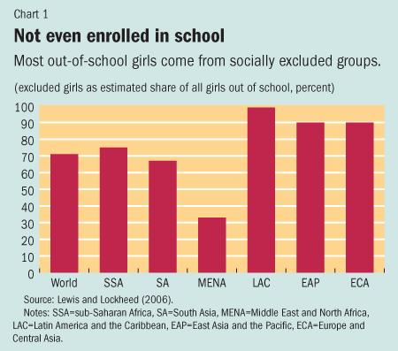

Slide 10
Citations
http://hispanicissues.umn.edu/assets/pdf/mor
na.pdf
http://www.zonalatina.com/Zldata55.htm

