Slide 1
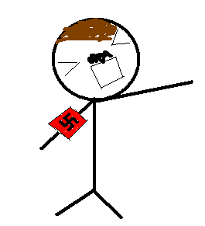
Hitler
1919 - 1939
Aralee Fajardo
Kai Taylor
Patrick Stascavage

Slide 2
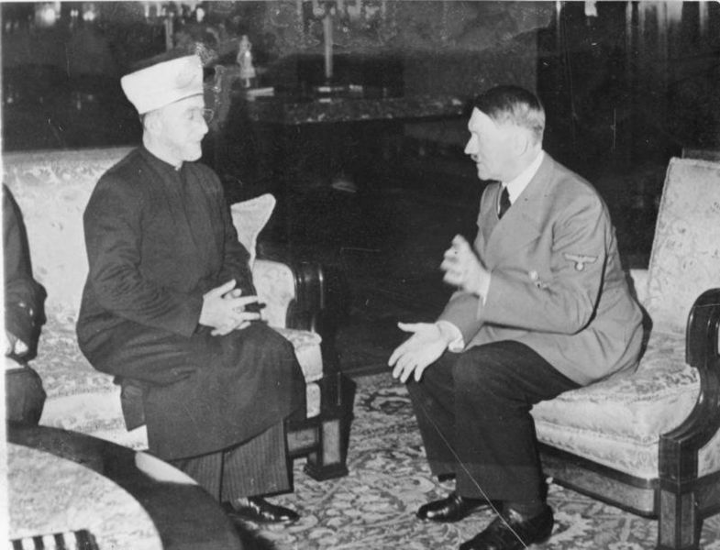
1
(http://i-cias.com/e.o//pahlavi1.htm)
Source A: 1933 - With the accession of Adolf Hitler as state leader of Germany, Reza Shah starts building close economic and political ties to the country.
Question: Why did Reza Shah start a connection with Hitler in his accession as a leader of Germany?

Slide 3
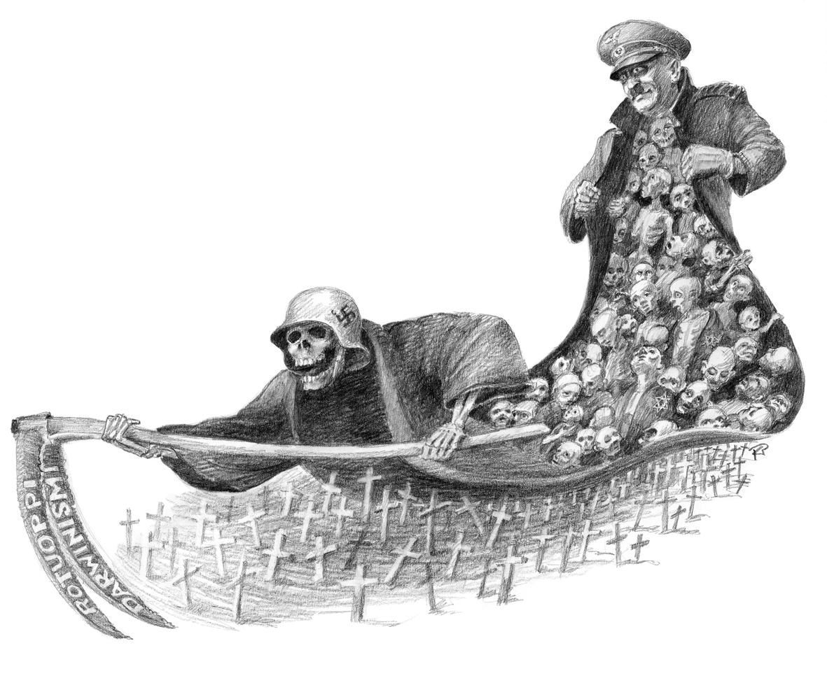
2
(http://www.helsinki.fi/~pjojala/Wikipedia_Famous_Jews.htm)
Source B: Jews had made this photo in the 1900s.
Question: What went through the Jew’s mind when they painted this artwork?

Slide 4
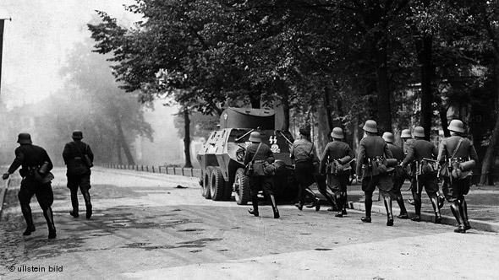
3
(http://www.dw-world.de/dw/article/0,,4616222,00.html)
Source C: After entering Danzig, the Nazi troops stormed the central post office in the start of WWII in 1939.
Question: By looking at this photo, assume how technologically advanced the Nazis were.

Slide 5
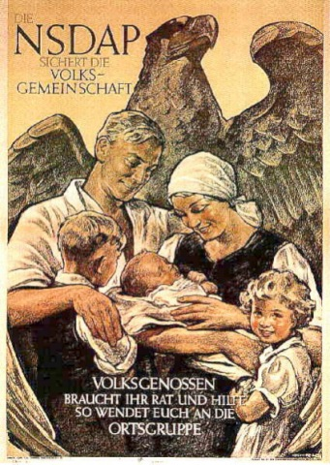
4
Question: In this propaganda what did Hitler want to encourage?
(uncp.edu)
Source D: Typical Nazi Propaganda

Slide 6
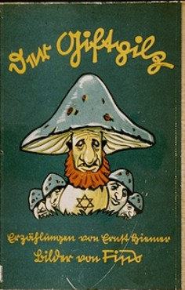
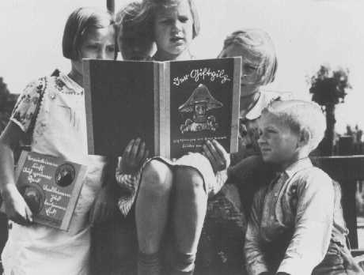
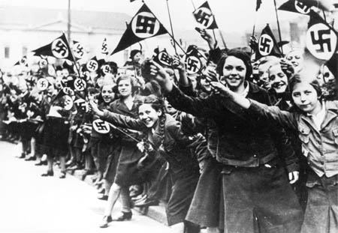
5
Question: To what extent did Hitler go to spread his views to his country of Germany in his reign?
(schikelgruber.net)
Source E: A parade of women on the street waiting
For Hitler to come.
(ushmm.org)
Source F: German children read an anti-Jewish propaganda book titled DER GIFTPILZ ( "The Poisonous Mushroom"). The girl on the left holds a companion volume, the translated title of which is "Trust No Fox." Germany, ca. 1938.

Slide 7
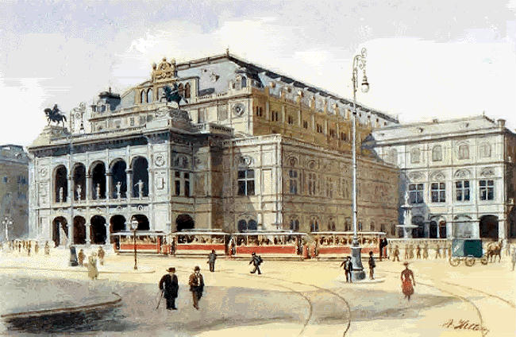
6
Question: What was Hitler’s view on society based on this source?
(uncp.edu)
Source G: Watercolor made by Adolf Hitler.

Slide 8
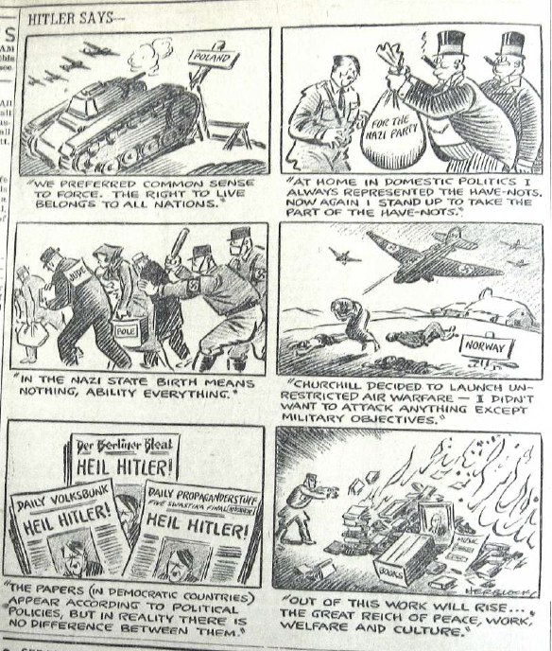
Source H:
7
Question: What does this source descibe Hitler as?
(hopkinsvillenostalgia.com)

Slide 9
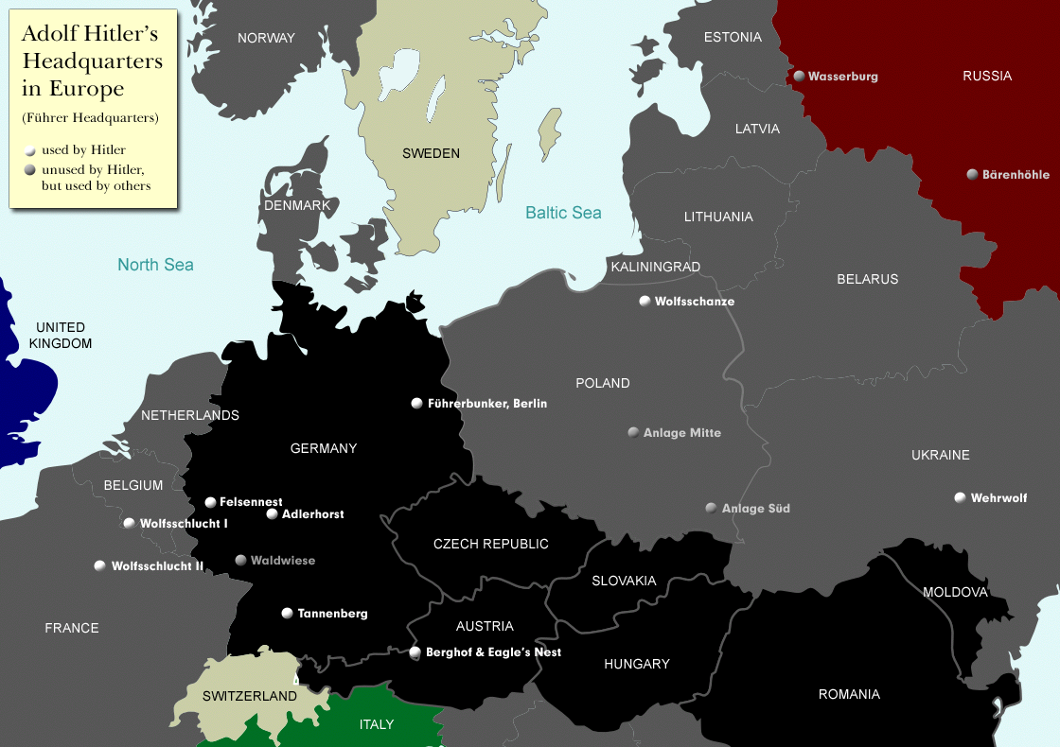
Source I:
8
Question: Guess which of Hitler’s owned Headquarters was the most useful to him.

Slide 10
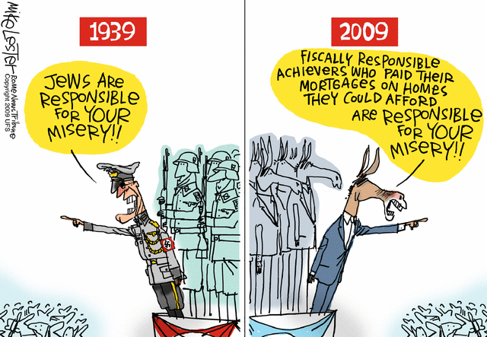
9
Source J:
Question: How did Hitler compare to other modern day leaders?

Slide 11
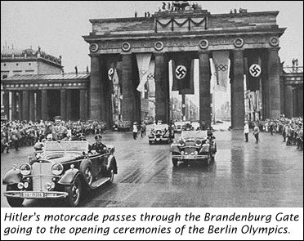
10
Source K:
Question: In examining the picture, guess what time period was this event.

