Slide 1
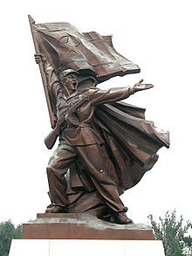
Difference in Governments
North Korea & South Korea
Alexis Burton and EDM

Slide 2
Section 1
Definitions and Backgrounds

Slide 3
Democracy & Communism
Democracy: form of government in which all citizens have an equal say in the decisions that affect their lives.
Communism: A sociopolitical movement that aims for a classless and stateless society structured upon common ownership of the means of production, free access to articles of consumption, and the end of wage labour and private property in the means of production and real estate.

Slide 4
Korean War
Review the following to orientate yourself on the Korean War 1950-1953. Take notes on the most significant of the events.
http://asianhistory.about.com/od/warsinasia/tp/Korean-War-Timeline.htm

Slide 5
North Korea
Was established its own country on September of 1948
Does not possess a form of democracy whatsoever.
Korean Workers' Party (Communist).
They are very Communistic to this day. Kim Jong-il is there ruler who creates walls (soldiers) around the country so that no one can leave and must worship him, in the form of a God like ruler.

Slide 6
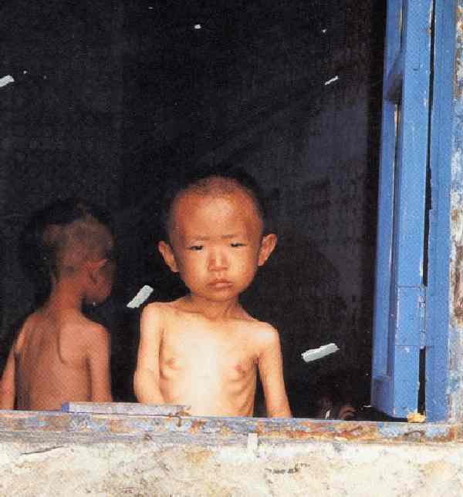
North Korea
North Korea is by far the greatest failure of all the Communist states. It is also one of the most dangerous of the former Communist countries because it possesses nuclear weapons, has a huge army, and sells advanced weaponry to rouge states.

Slide 7
South Korea
Established its own country on August 1948.
Republic
South Korea is sovereign state.
Since the Korean War, the South Korean Government pursued a policy of unrelenting hostility to North Korean and its Communist regime. In recent years, South Korean Governments have pursued what they call the Sunshine Policy. This change occurred when South Korea emerged from military governments to democratically elected governments.

Slide 8
South Korea
The Sunshine Policy was based on the idea that dropping the official policy of hostility would help develop positive contacts with the North and gradually change the nature of the North Korean regime.
The South wanted to be “friends” with the North.
South Korea is ruled by a democratic government and the government wants to hear from the people and to satisfy their needs.

Slide 9
North and South Korea today
North Korea is still an authoritarian country.
South Korea is an egalitarian government.

Slide 10
Questions Section 1
What evidence of bias exists in the text of this PowerPoint.
Why did the Korean War begin?
Why was the Korean War a “forgotten war?”
What is the essential difference between North and South Korea?
What missing information would complete your view of North and South Korea?

Slide 11
Section 2 South Korea’s Sunshine Policy

Slide 12
South Korea’s Sunshine Policy
SUNSHINE POLICY IN A NUTSHELL
What is Sunshine Policy? 1. Definitions
The Korean Peninsula is a region in suspended animation. It is trapped in an anachronistic atmosphere of mistrust and conflict when the rest of the world has moved on to the post-Cold War era; two states locked in silent confrontation across a hostile border. But we simply cannot allow the north-south relation to be hostage to an unending political war of attrition.
The sunshine policy seeks to bring about a state of peaceful coexistence in the Korean Peninsula by effecting changes in North Korea through reconciliation, cooperation, and mutual exchange, all founded upon a basis of airtight national security.
The Government of the People has designed the sunshine policy to encourage North Korean reform and openness, which will lead to lifting of tensions between the North and the South and concomitantly end the state of confrontation between the two. It is also a policy guided by three unwavering principles of zero-tolerance for aggression, renunciation of unification through absorption, and an active drive for reconciliation and mutual exchange.
The three guiding principles driving this policy makes it the most realistic policy that can terminate the state of confrontation, and lead the Koreas to mutual prosperity based on coexistence, cooperation, and exchange.

Slide 13
South Korea’s Sunshine Policy
2. What Makes it Right
The old policy of political isolation and containment of North Korea has been abandoned for one of assistance and cooperation, and it is hoped that it will create an atmosphere conducive to change and reform in the north. Such is the logic and justification that belies the sunshine policy.
First, it is a policy with historical precedence in its favor. No policy aimed at bringing down totalitarian regimes by political pressure and containment has ever succeeded, as demonstrated by US policies toward Cuba, Libya, and Iraq, with closer examples being provided by past ROK policies towards the north.
Second. North Korea fears possible detrimental effects improvement in Inter-Korean relations and reform could have on their regime. If we can show North Korea that they have nothing to lose and everything to gain from economic cooperation induced by the sunshine policy, it may alleviate their tendency for military adventurism towards the south.

Slide 14
South Korea’s Sunshine Policy
Third, an arms race triggered by increased political and military tension can create major obstacles for our efforts to surmount the IMF crisis by keeping foreign investment away, and could lead to aggression by a desperate North Korean regime.
Fourth, it can assuage North Korean fears that reform and improving relations must necessarily lead to an implosion of their state, which can establish an atmosphere where North Korea would feel comfortable in opening up voluntarily.
Fifth, the surrounding powers still have vested interests at stake in the Korean peninsula, and their support for the sunshine policy does not leave much room for deviation.
Sixth, it is a policy decided through necessary decision-making processes and passed muster with public opinion.

Slide 15
South Korea’s Sunshine Policy
3. The Difference
First, the policy gives priority to achieving political stability under present conditions over trying to fulfill unrealistic expectations of immediate reunification.
Second, it is a policy standing upon a firm basis of national security, and a deft combination of maintaining security while improving North-South relations, as attested by its Three Guiding Principles.
Third, the ROK acts and not reacts to North Korea by actively pursuing its own northern policy under its own terms, and only an active policy can induce changes in North Korea.

Slide 16
South Korea’s Sunshine Policy
Northern and International Reaction to the Policy 1. North Korean Attitudes
Fervent denunciation has been North Korea's first reaction to the policy. They have been calling it a "Smokescreen to cover preparations for an invasion and an attempt to dismantle our country from within", and saying that "All the world knows such backbiting treachery will never succeed against us". North Korean attitudes toward separation of economic and more political issues had been encouraging, however, as they realize that they have nothing to lose and some real benefits to gain from cooperation.
The basic nature of North Korea's reaction to the policy can be best described as two-sided. Their criticism of the policy as a political assault on their system has not prevented them from being receptive to certain 'profitable' proposals they deem as having political justification. Sunshine policy seeks to make mutual beneficiaries out of both Koreas, and it is hoped that it will improve interKorean relations through real cooperation, pending North Korea's recognition of its basic purpose.

Slide 17
South Korea’s Sunshine Policy
2. International Acknowledgement
The policy is in agreement with the spirit of the US, Chinese, and Japanese stance towards North Korea, and wholehearted support from those countries was forthcoming.
The US has held President Kim's efforts toward peace on the peninsula and interKorean reconciliation in high regard. The plan is to proceed in stages. It would first foster and increase exchange in the civilian sector, then expand into cooperation on the government level, for coexistence and co-prosperity between the two Koreas. It treats politics and cooperation as separate issues, and the US considers it the most realistic policy given the situation on the peninsula. The policy also displays similarities with Japan's North Korea policy, and has received positive consideration from its government as well. China and Russia have engaged in a corresponding policy of economic support for North Korea, such as supply of needed food and petroleum to the impoverished country, to prevent Northeast Asian security being placed under jeopardy by a possible implosion of the DPRK.

Slide 18
South Korea’s Sunshine Policy
93.4 percent of all North Korea/Unification specialists who participated in the Ministry of Unification survey after infiltration by a North Korean submarine insist that sunshine policy must still advance despite the incident. Moreover, there is no diminution in public support for the sunshine policy, the midget sub intrusion and the discovery of a northern agent's body notwithstanding.
[ INTERNATIONAL COOPERATION ]
The ROK-US summit and the Korea-Japan Security Conference have not only succeeded in securing American and Japanese support for the policy, but also ensured close coordination with the two countries in all their future policies concerning North Korea.
A common understanding of the issues involved in establishing peace on the Korean Peninsula was reached between the US and China during a US presidential visit to the PRC, and it could create a synergistic effect in combination with the expansion of security channels among the ROK, China and Russia in solidifying the security regime, given support and cooperation by the surrounding powers.

Slide 19
Section 3 North Korea Government

Slide 20
Government: North Korea
GOVERNMENT AND POLITICAL CONDITIONS North Korea has a centralized government under the rigid control of the communist Korean Workers' Party (KWP), to which all government officials belong. A few minor political parties are allowed to exist in name only. Kim Il-sung ruled North Korea from 1948 until his death in July 1994 as Secretary General of the KWP and President of North Korea. The latter post was abolished following Kim Il-sung’s death and the title of the Eternal President of the Republic was established and given to Kim Il-sung.

Slide 21
Government North Korea
Little is known about the actual lines of power and authority in the North Korean Government despite the formal structure set forth in its constitution. Following the death of Kim Il-sung, his son, Kim Jong-il, inherited supreme power. Kim Jong-il was named General Secretary of the KWP in October 1997, and in September 1998, the Supreme People's Assembly (SPA) reconfirmed Kim Jong-il as Chairman of the National Defense Commission (NDC) and declared that position as the "highest office of state." However, the President of the Presidium of the SPA, Kim Yong-nam, serves as the nominal head of state. North Korea's 1972 constitution was amended in late 1992, September 1998, and April 2009.

Slide 22
Government North Korea
Three key entities control the government of the D.P.R.K. The cabinet, formerly known as the State Administration Council (SAC), administers the ministries and has a significant role in implementing policy. The cabinet is headed by the premier and is the dominant administrative and executive agency. The NDC is responsible for external and internal security, and under the leadership of Kim Jong-il the NDC has assumed a significant role in influencing policy. The Politburo of the Central People’s Committee is the top policymaking body of the KWP, which also plays a role as the dominant social institution in North Korea.

Slide 23
Government North Korea
Officially, the D.P.R.K.’s legislature, the Supreme People’s Assembly, is the highest organ of state power. Its members are elected every 4 years. Usually only two meetings are held annually, each lasting a few days. A standing committee elected by the SPA performs legislative functions when the Assembly is not in session. In reality, the SPA serves only to ratify decisions made by the ruling KWP.

Slide 24
Government North Korea
North Korea's judiciary is "accountable" to the SPA and the president. The SPA's standing committee also appoints judges to the highest court for 4-year terms that are concurrent with those of the Assembly. Administratively, North Korea is divided into nine provinces and two provincial-level municipalities--Pyongyang and Nasun (also known as Najin-Sonbong). It also appears to be divided into nine military districts.

Slide 25
Section 3 Questions
1. What role does the international community have in determining the outcome of the governments in Other countries. Consider the Korean Peninsula, Polish Partitioning, and the end of South African Apartheid in your answer.
2. How does authoritarian rule establish itself through the development of systems?

Slide 26
Section 4: Further Viewing
http://topdocumentaryfilms.com/welcome-to-north-korea/

Slide 27
Section 5: Assignment Options
Do one of the assignments listed in this section

Slide 28
Assignment: Option A (Chose 1)
Use NK Government notes to assist you in answering one question below
Compare North Korea’s political set up with that of the USSR. Consider how political set up can assist (or destroy) a country (e.g. Poland’s sejm and the liberum veto)
Compare North Korea’s commitment to Communist ideals to that of China. Consider how difficult it is to go against the mainstream ideals of the day (e.g. Democracy in the world of autocratic empires)
Compare the leadership of North Korea to that of the Absolute Monarchs of early modern Europe. Consider the need to have ideals precede the rule of the autocrats.

Slide 29
Assignment Option B (Chose 1)
Use info on SK to answer one question below
Compare South Korea’s Sunshine Policy with that of the Good Friday Agreement of Northern Ireland. Consider the danger of peace agreements to parties in power (e.g. the Polish Constitution of May 3rd)
Compare South Korea’s Sunshine Policy with that of the Daytona Accords in former Yugoslavia. Consider the differing perspective rulers have on new governmental documents.
Compare South Korea’s Sunshine Policy with that of the “peace” between Israel and the Palestinians. Consider the long lasting conflict between Poland and Russia.

Slide 30
Assignment Option C (Chose 1)
Use video to answer one of the questions below
Compare the influence of leadership in autocratic societies to that of democratic societies. Consider the Polish road to democracy in your answer.
Compare the North Korean world after the death of their “beloved leader” vs. that of the Soviet world after the death of Joseph Stalin. Consider the lasting effects of rulers such as Catherine the Great vs. the lasting effect of Poniatowski in your answer)
To what extent is authoritarian rule (such as that of NK or that of Catherine the Great) a mirage that must be fogged over to succeed?

Slide 31
Section 6: Citations
http://histclo.com/essay/war/com/wc-nk.html
http://www.state.gov/r/pa/ei/bgn/2792.htm
http://www.fas.org/news/skorea/1999/reunification22.html
http://asianhistory.about.com/od/warsinasia/tp/Korean-War-Timeline.htm
http://topdocumentaryfilms.com/welcome-to-north-korea/

