Slide 1
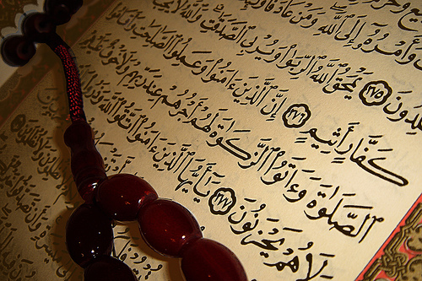
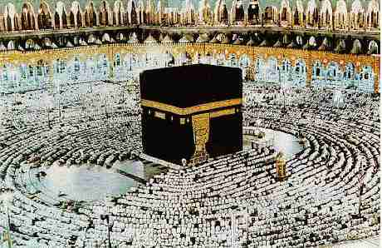
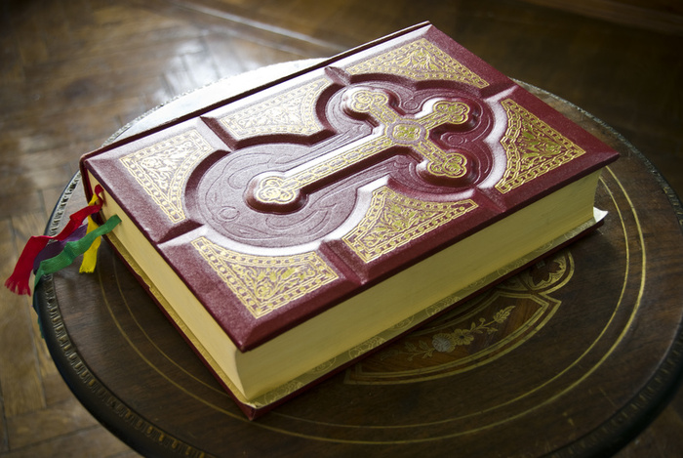
Dar al Islam & Christian Theology

Slide 2
5 Ws of Christianity

Slide 3
Who
Muhammad was the founder of the Islamic empire.

Slide 4
What
There is only one God
Six Articles of Faith
Islam means submission in Arabic
http://www.religionfacts.com/islam/beliefs.htm

Slide 5
When and Where
Founded 622 CE
Palestine

Slide 6
Why and How
Islam was created because the prophet Muhammad was sent by god as a message deliverer to the people according to the religion
It was created by Muhammad spreading the word of Allah
http://wiki.answers.com/Q/Why_was_Islam_created

Slide 7
5 Ws of Christianity

Slide 8
Who and What
Jesus created Christianity
Ten commandments
The Bible

Slide 9
When and Where
Christianity emerged from judiasm about 10 CE
Middle East

Slide 10
Why and How
It was created because God gave a son to Mary and instructed that son (Jesus) to do so
Christianity spread its influence first by Jesus preaching throughout the Middle East and then by the church

Slide 11
Comparing

Slide 12
Both religions have one god. They are mono theistic.

Slide 13
They both believe that there is a Heaven

Slide 14
There is some kind of prophet that received a set of laws from God.

Slide 15
Contrasting

Slide 16
Their Version of the Bible is the Qur’an
http://www.religionfacts.com/islam/beliefs.htm

Slide 17
Most people that are Christians are white.

Slide 18
Muslims worship at mosques on their hands and knees while Christians sit in pews at a church.

Slide 19
Question
And
Answer

Slide 20
When was Christianity established?
- 30 A.D.

Slide 21
Who were the founders of Christianity?
- Jesus, Peter, and Paul

Slide 22
What were Christianity’s original languages?
- Aramaic and Greek

Slide 23
What is Christianity’s size rank in the world?
- Number one in the world

Slide 24
What are the religions that branch off of Christianity?
-Catholic -Orthodox -Protestant

Slide 25
What is the Christianity text?
- The Holy Bible

Slide 26
Who was the Christian prophet and King of the Jews?
- Jesus Christ

Slide 27
The name of the good Christian afterlife?
- Heaven

Slide 28
The name of the bad Christian afterlife?
- Hell

Slide 29
Most important Christian holidays?
- Christmas - Easter

Slide 30
Where was Christianity founded?
- Palestine

Slide 31
What year was Islam established?
- 622 C.E.

Slide 32
Original languages of the Islam language?
- Arabic

Slide 33
What religion is Islam rank in the religion?
- The second largest in the world

Slide 34
What are the major branches of Islam?
- Sunni, - Shiite

Slide 35
The name of the good Islam afterlife is called?
- Eternal paradise

Slide 36
The name of the bad Islam afterlife is called?
- Eternal hell

Slide 37
Important Islam holidays
- Mawlid - Ashura

